Slide 1
Sulawesi Stress Inversion

Slide 2
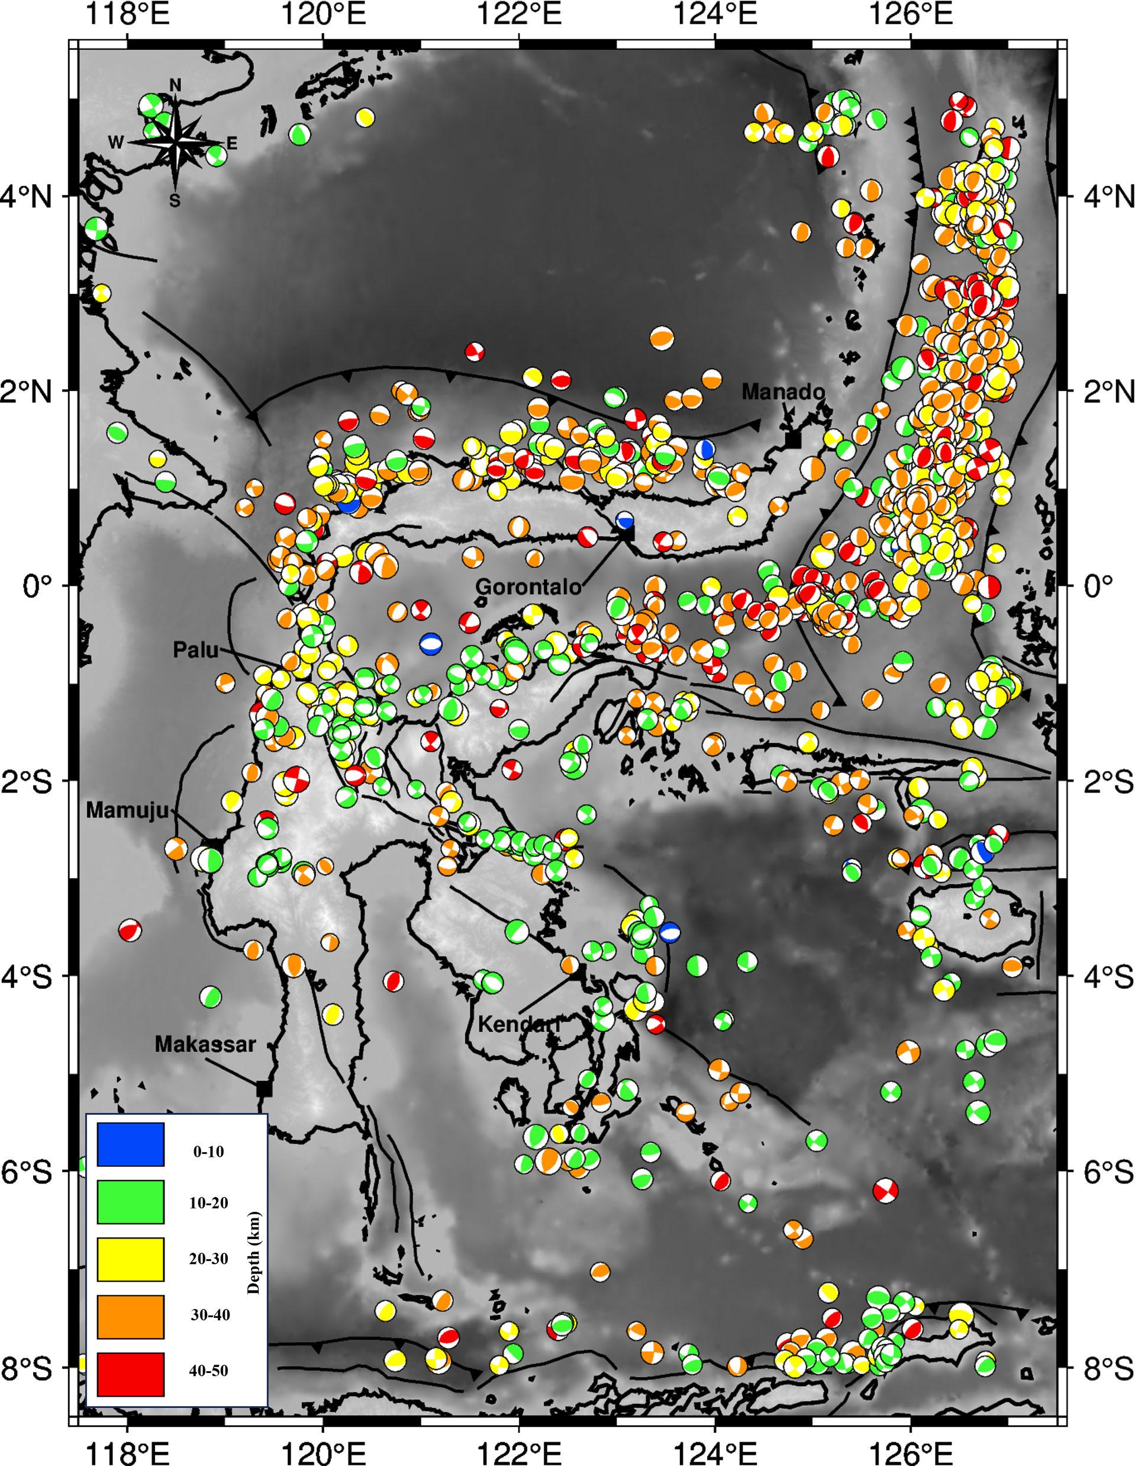
Focal Mechanism Data
Map showing the distribution of 1390 focal mechanisms data, with 4.0 < Mw < 7.0 and depth ≤ 50 km from April 1967 until September 2022. The surface fault traces around Sulawesi Island were obtained from. The red box indicates the major city with highly dense population.

Slide 3
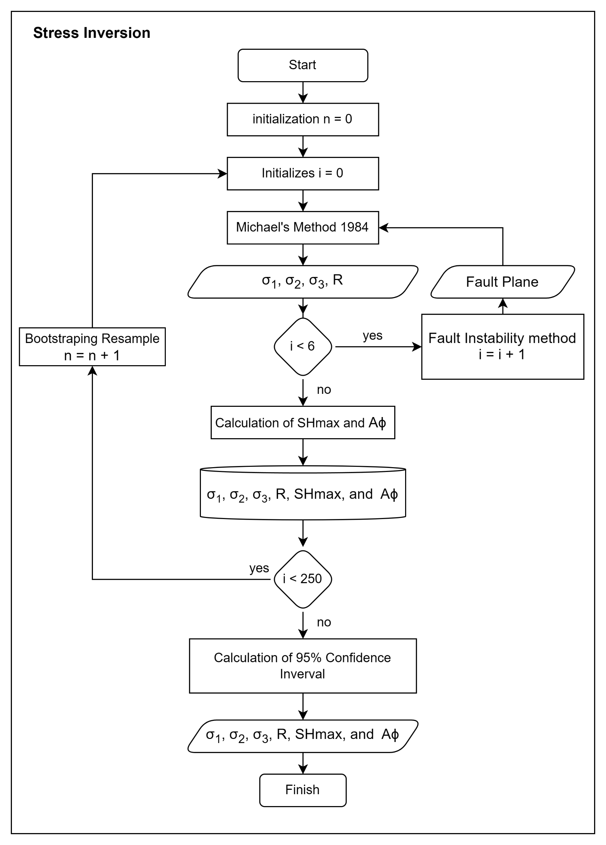
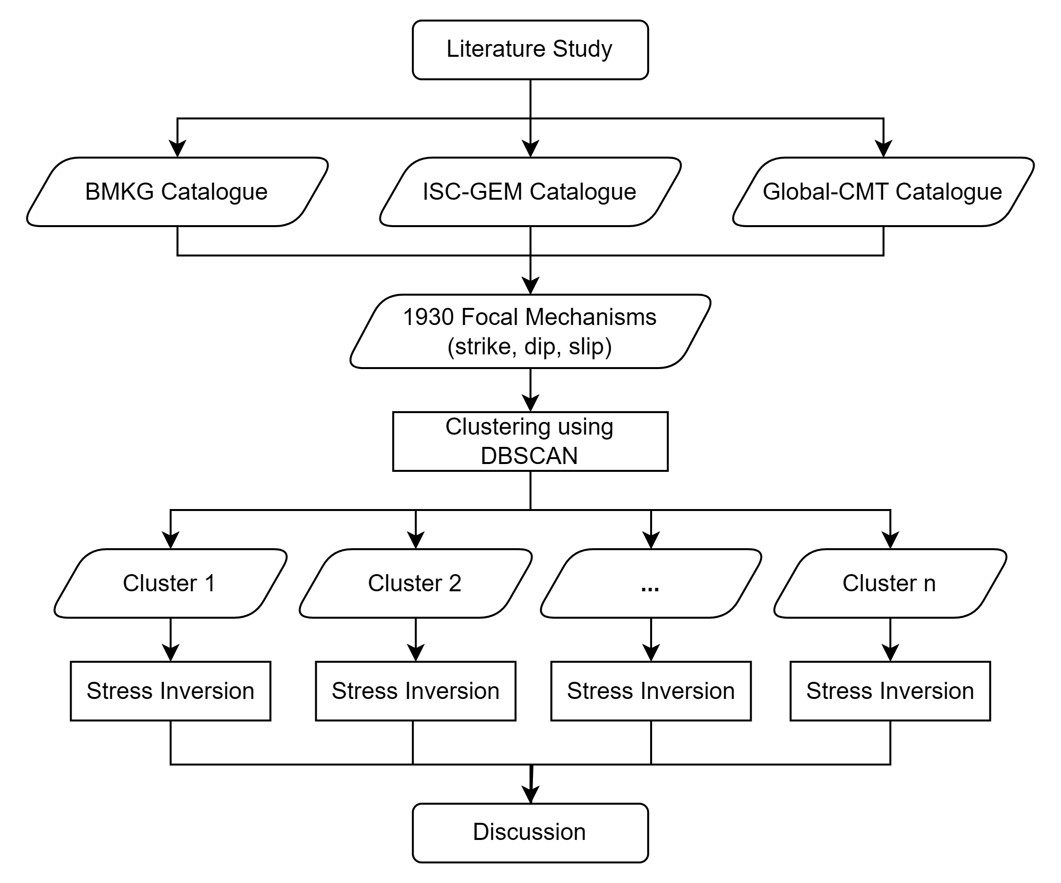
Methods
The stress inversion process was performed using a modification of the STRESSINVERSE Algorithm (Vavrycuk, 2014) by adding SHmax and Simpson's Index calculations.
Measurement uncertainty was calculated using the bootstrap resample method with 250 samples.

Slide 4
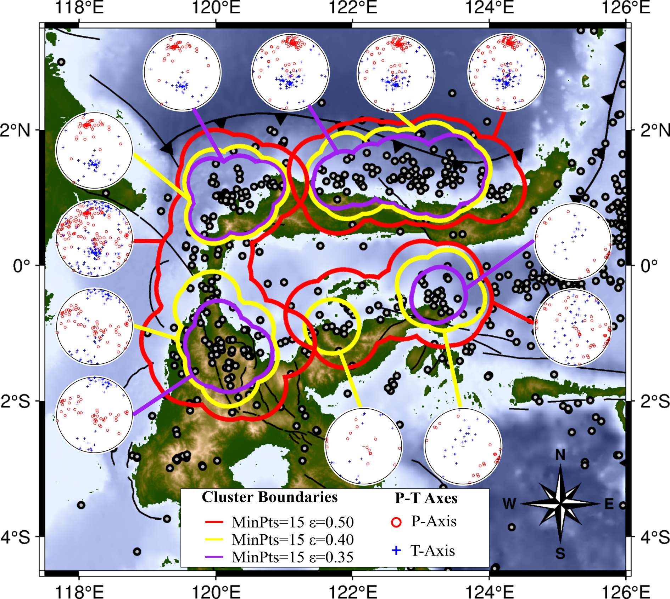
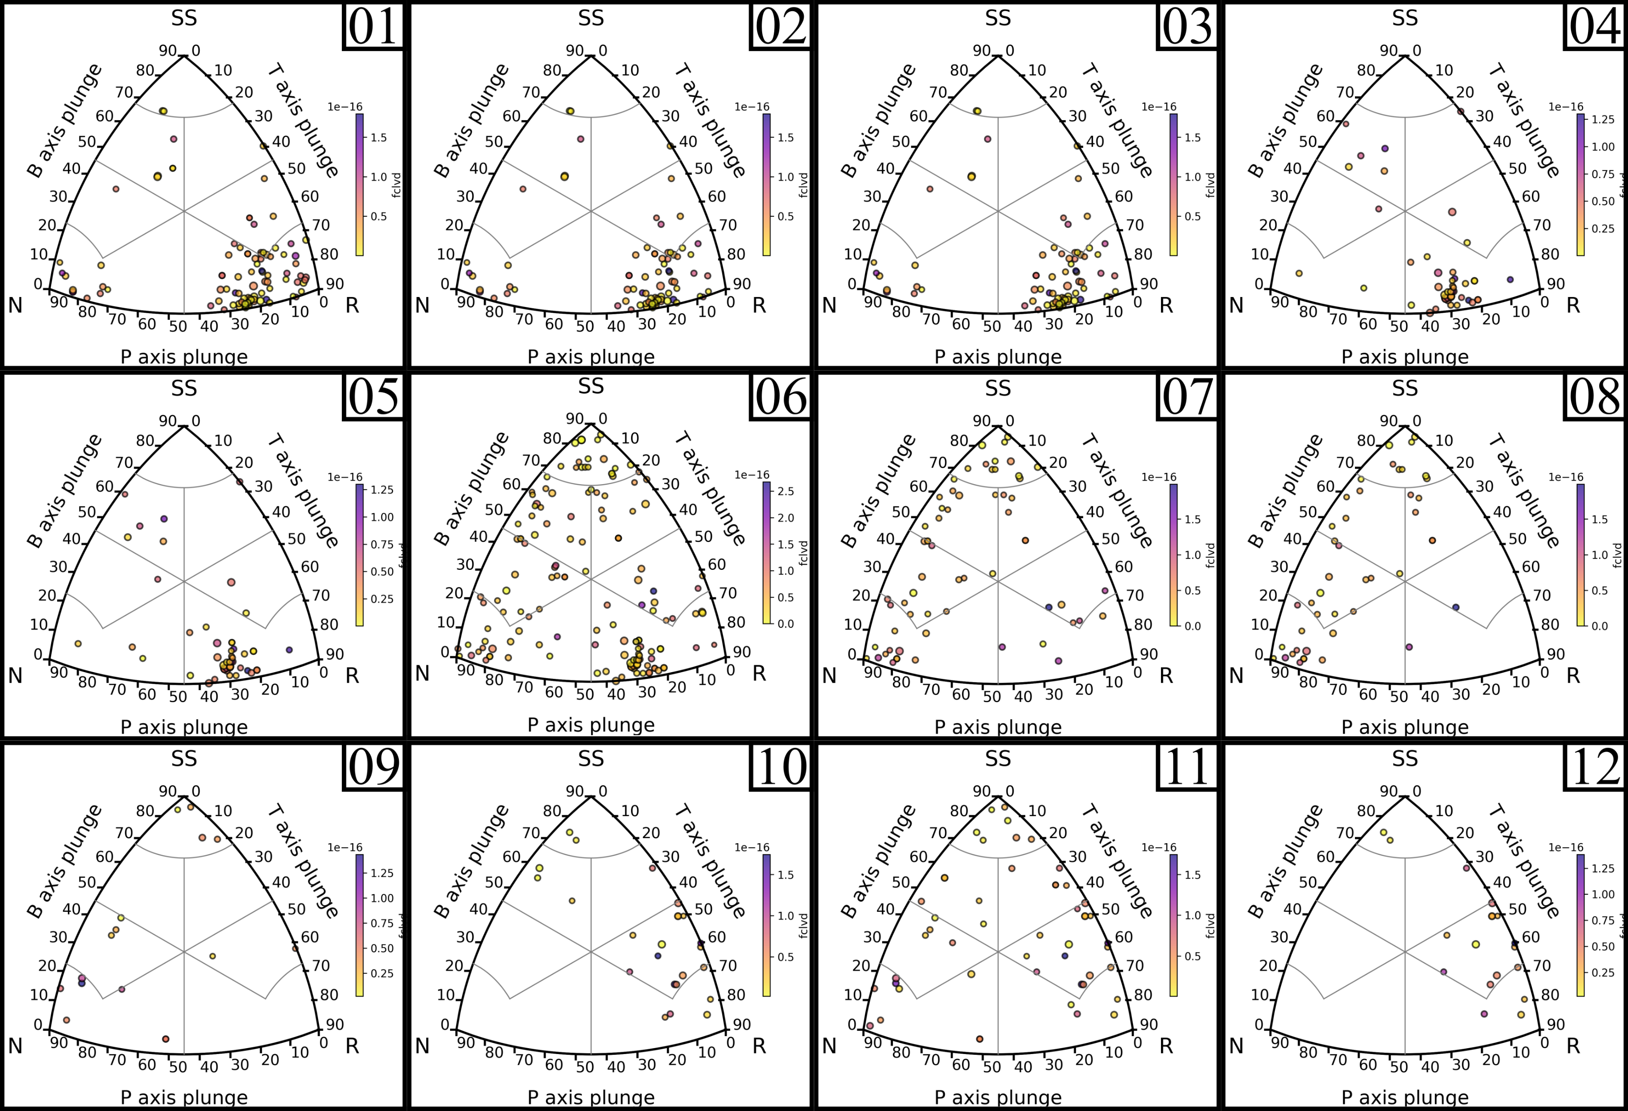
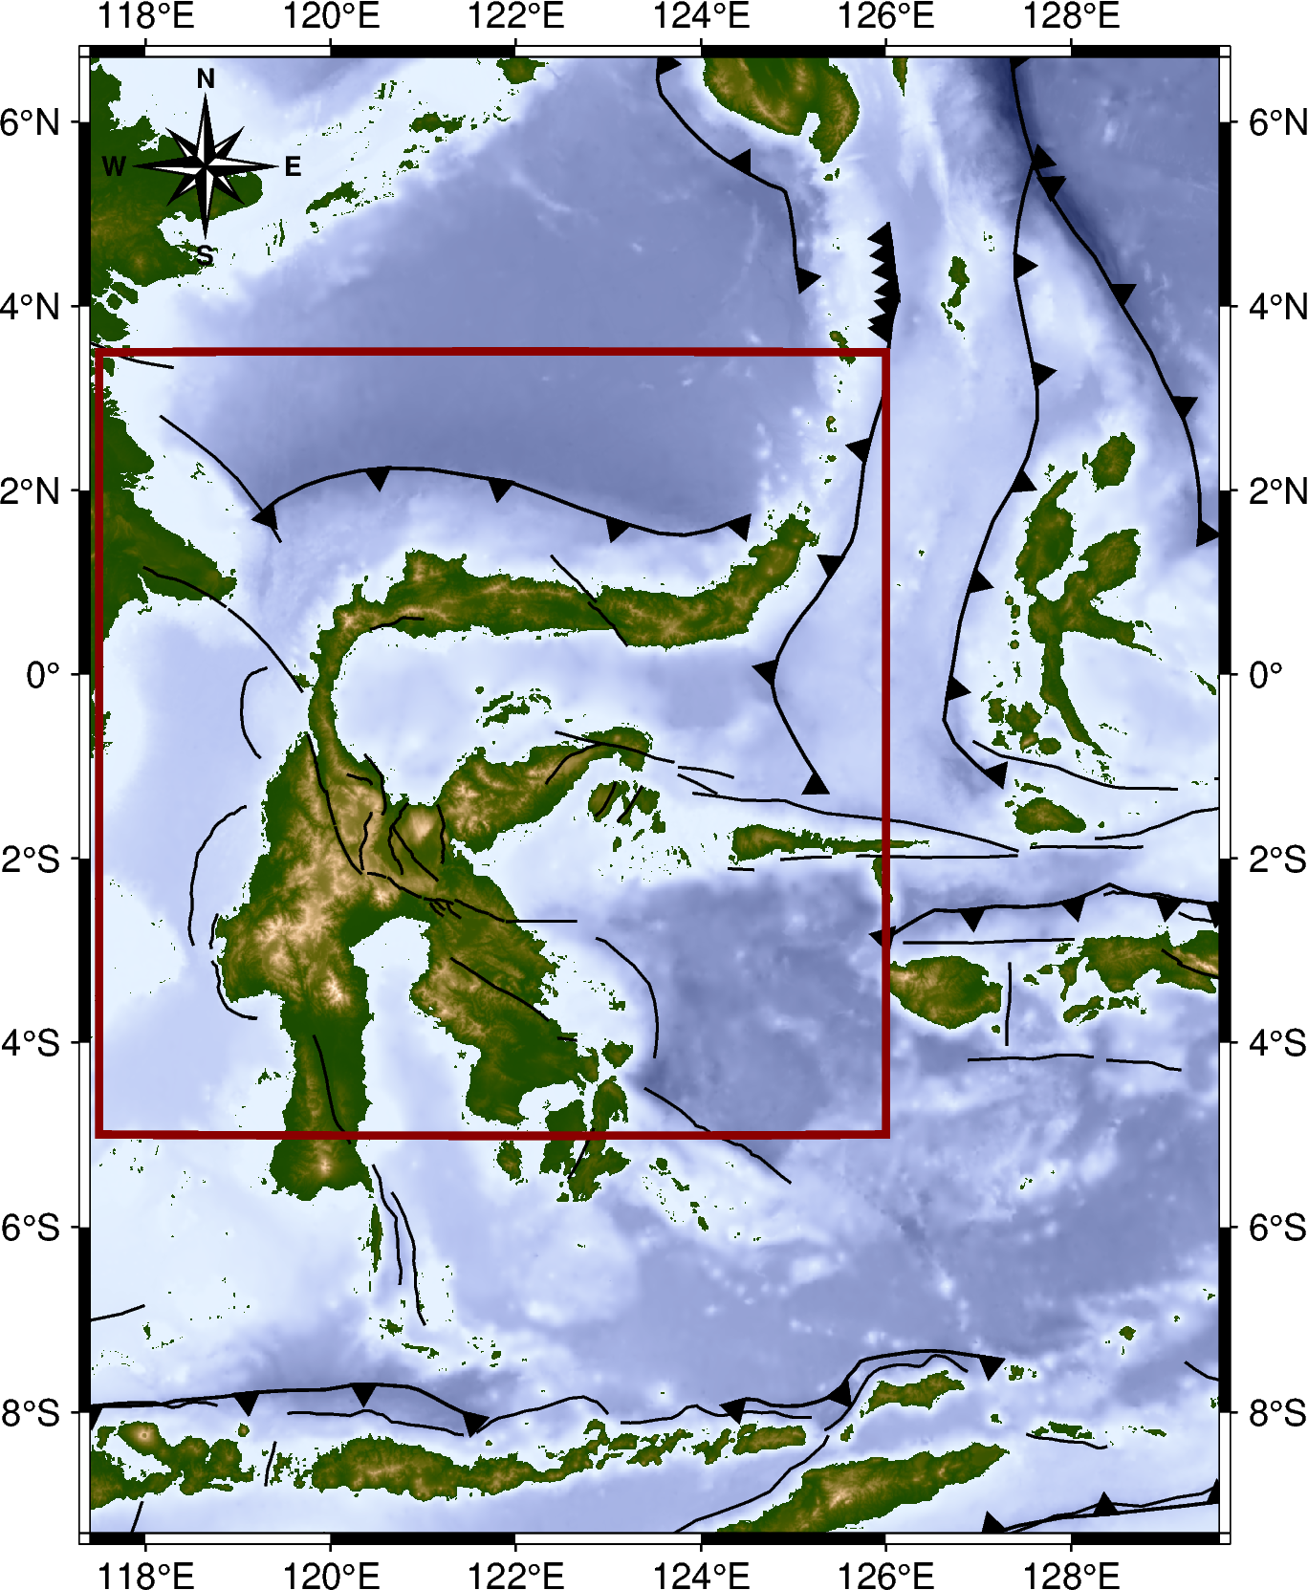
$$Clustering Result$$
Northern Sulawesi
04
03
02
01
05
06
12
07
11
08
09
10

Slide 5
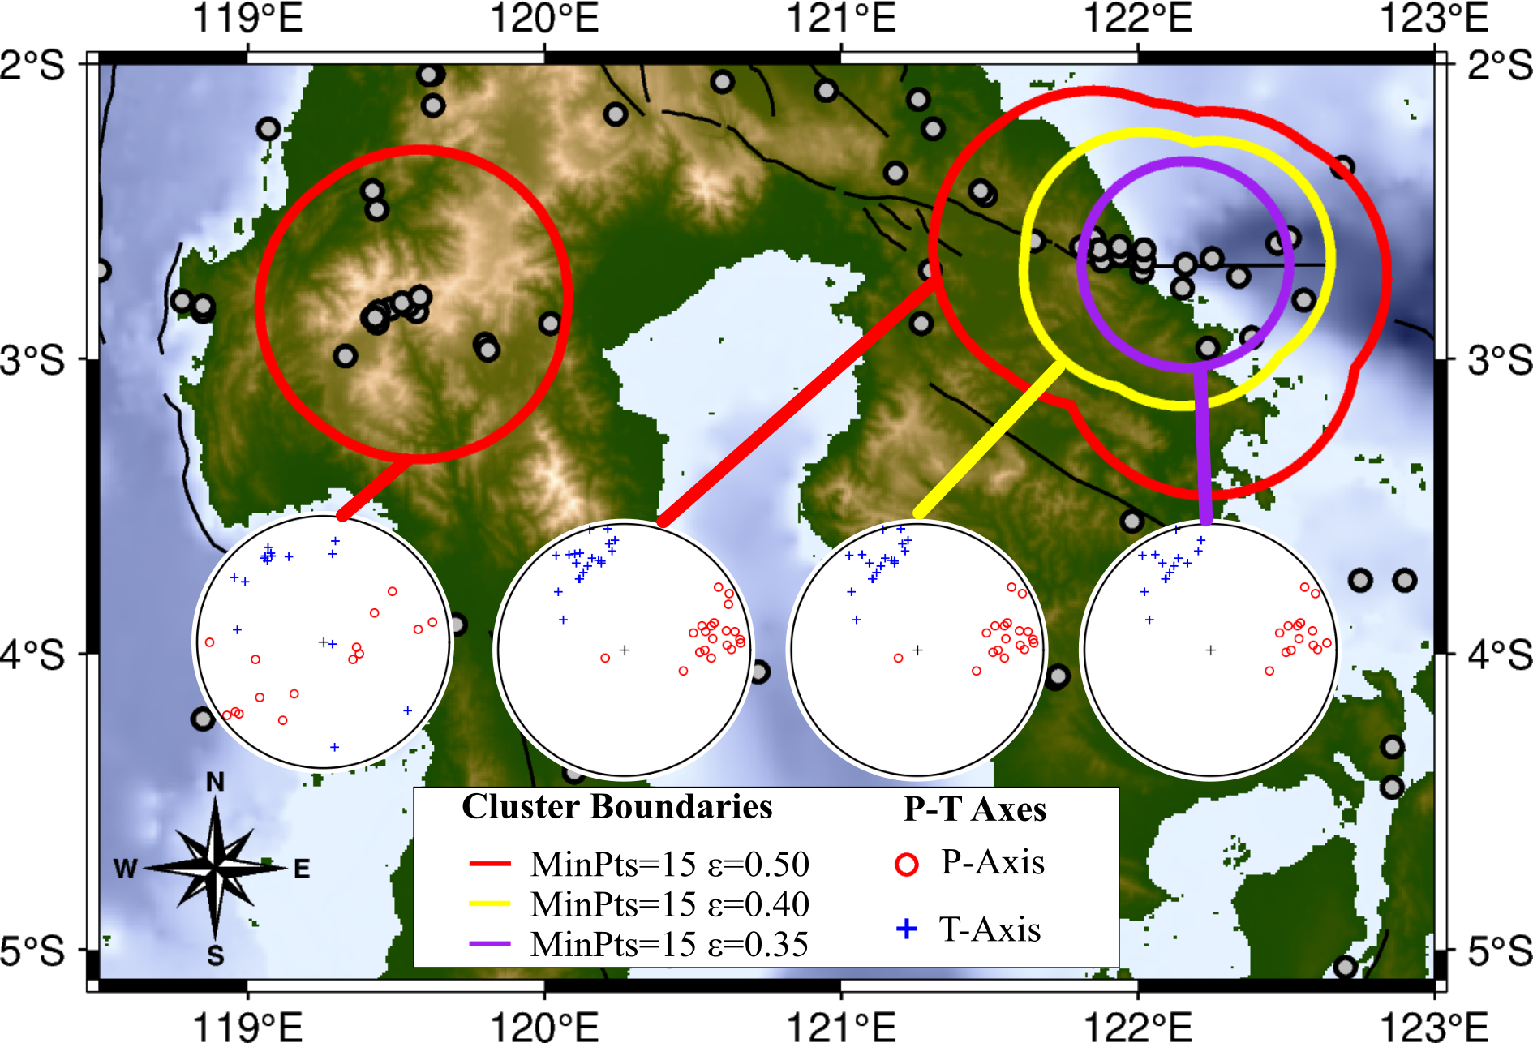
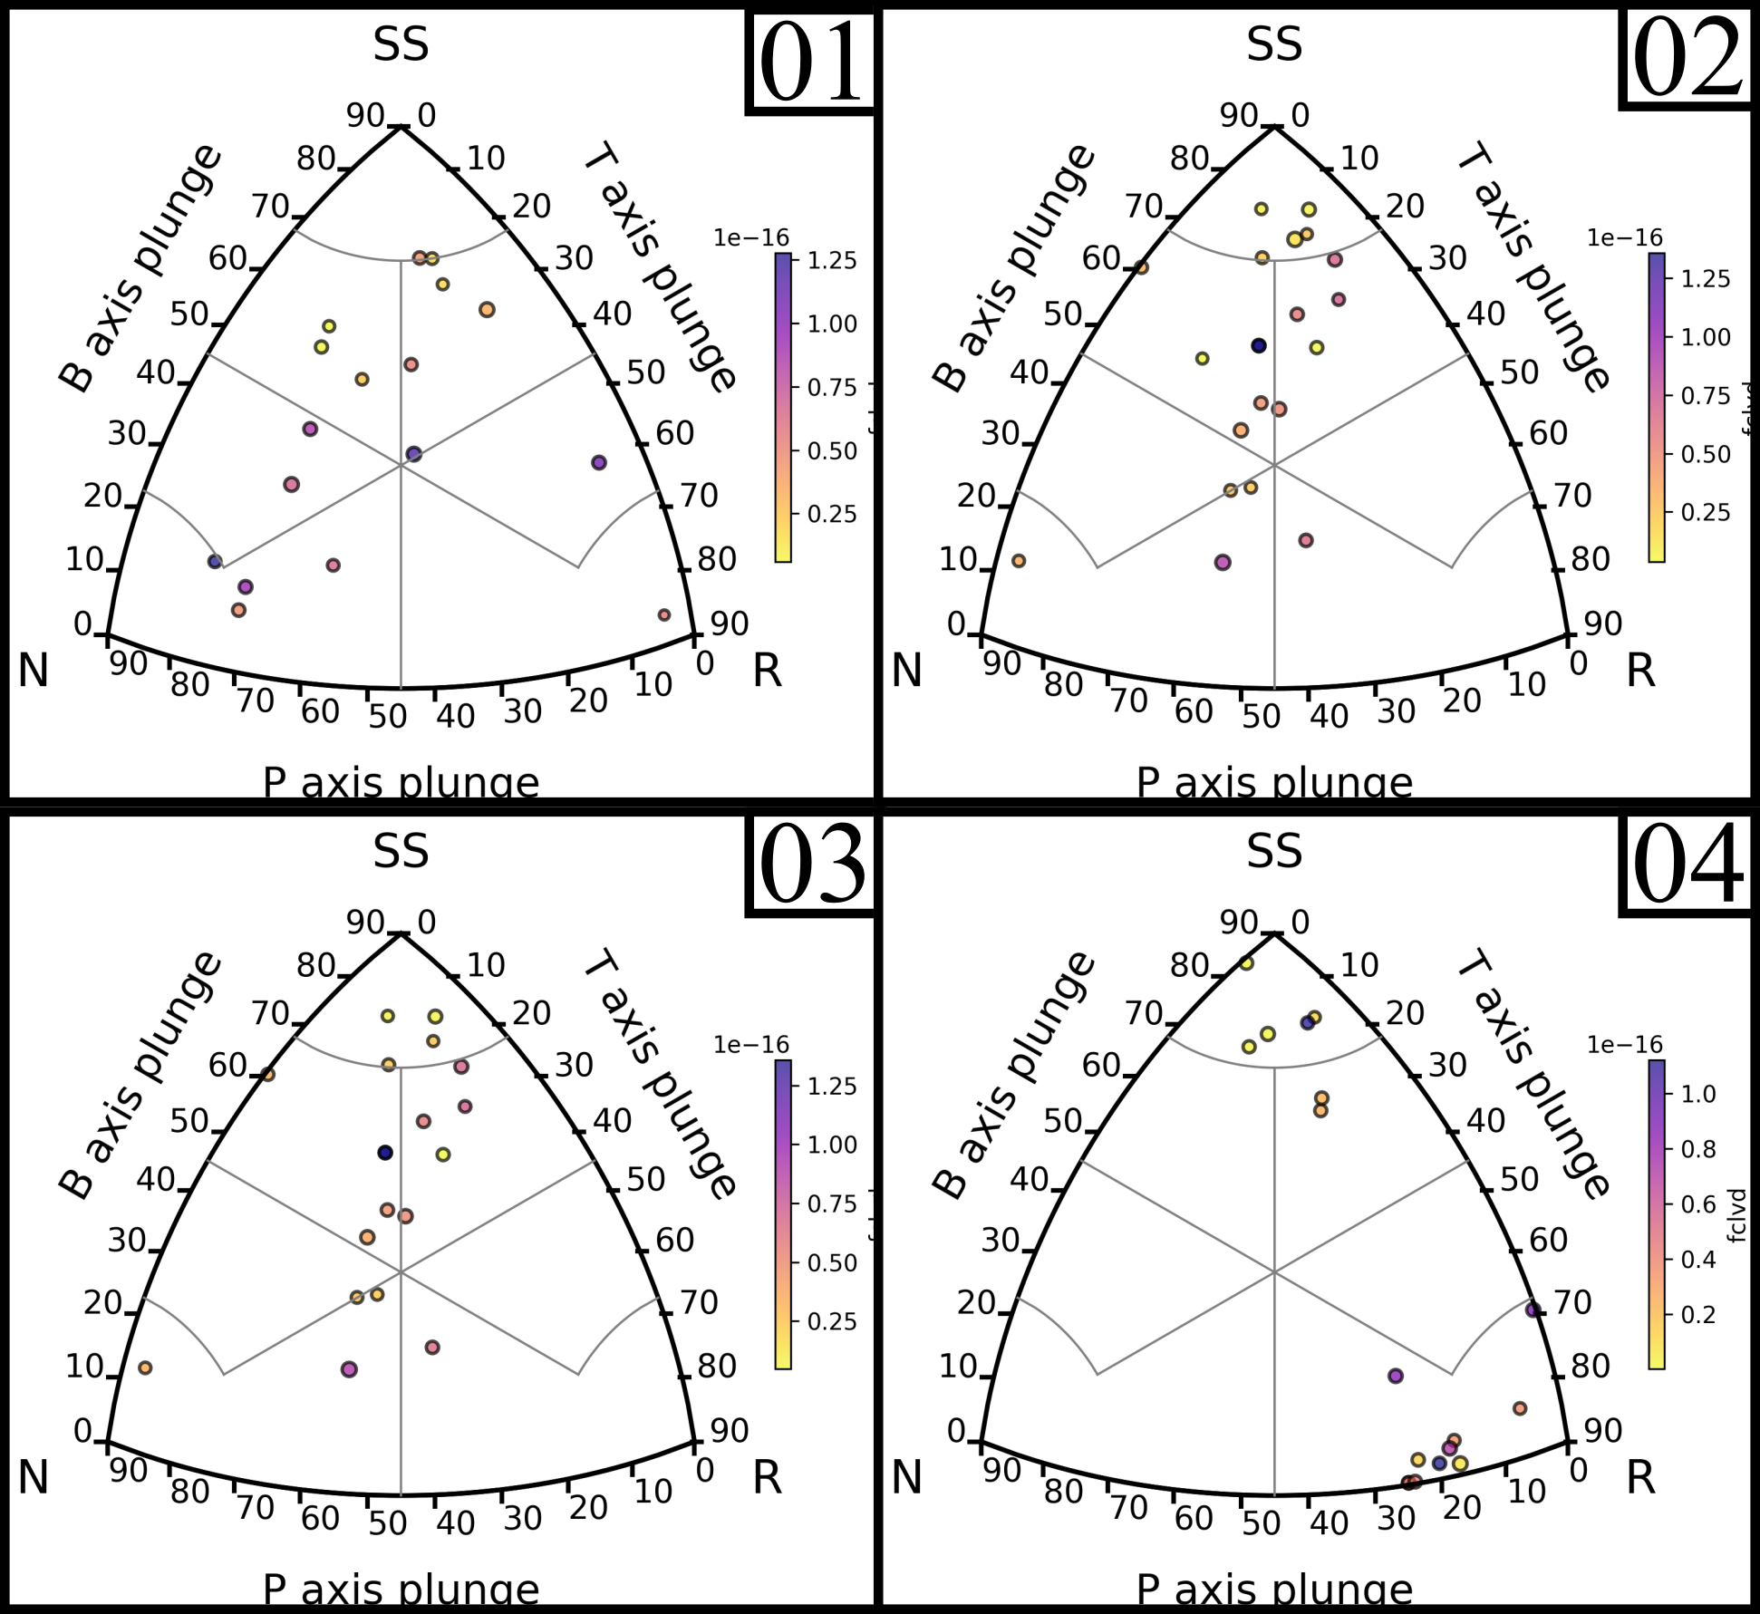
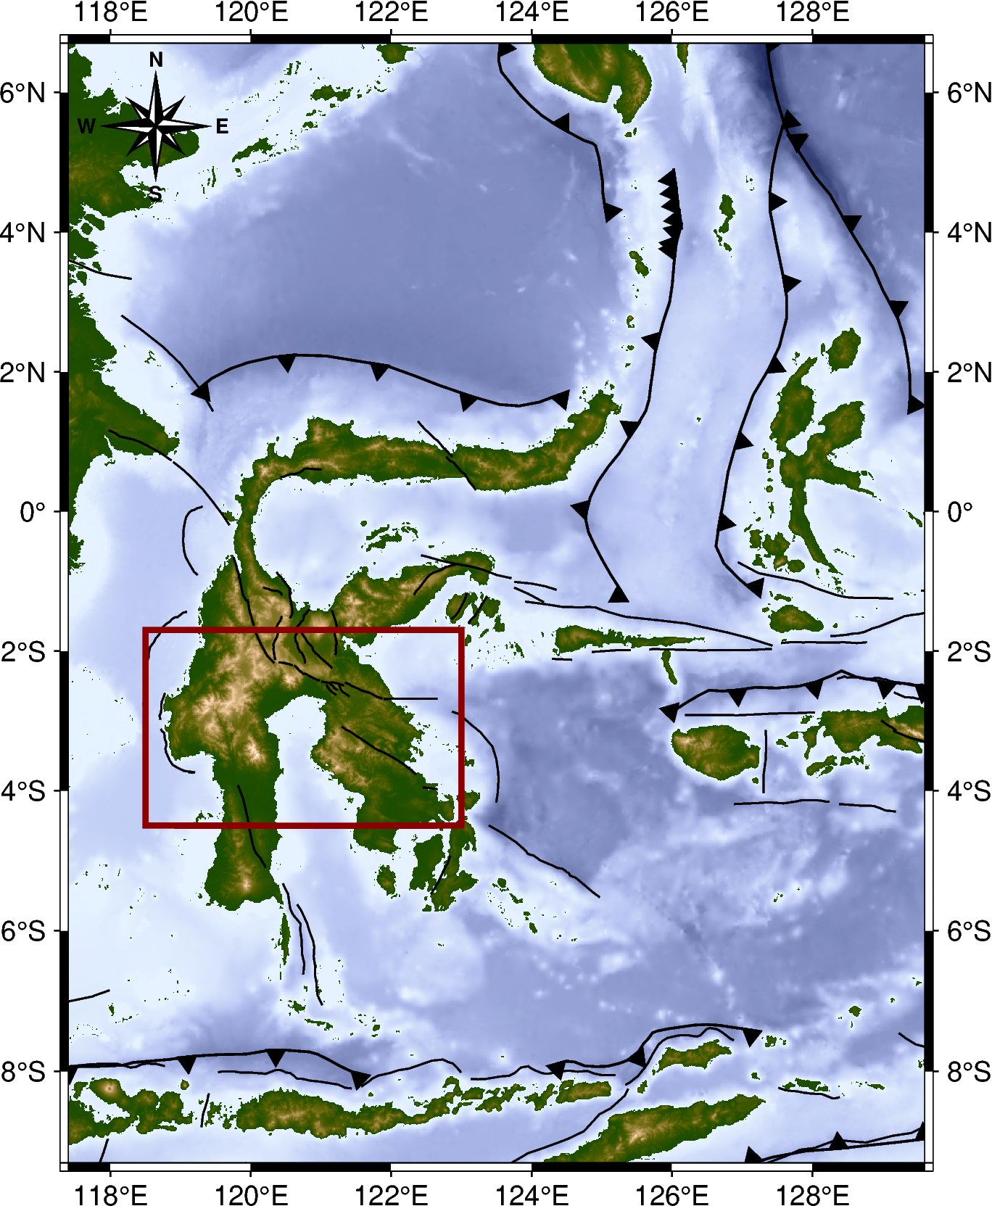
$$Clustering Result$$
Southern Sulawesi
01
02
03
04

Slide 6
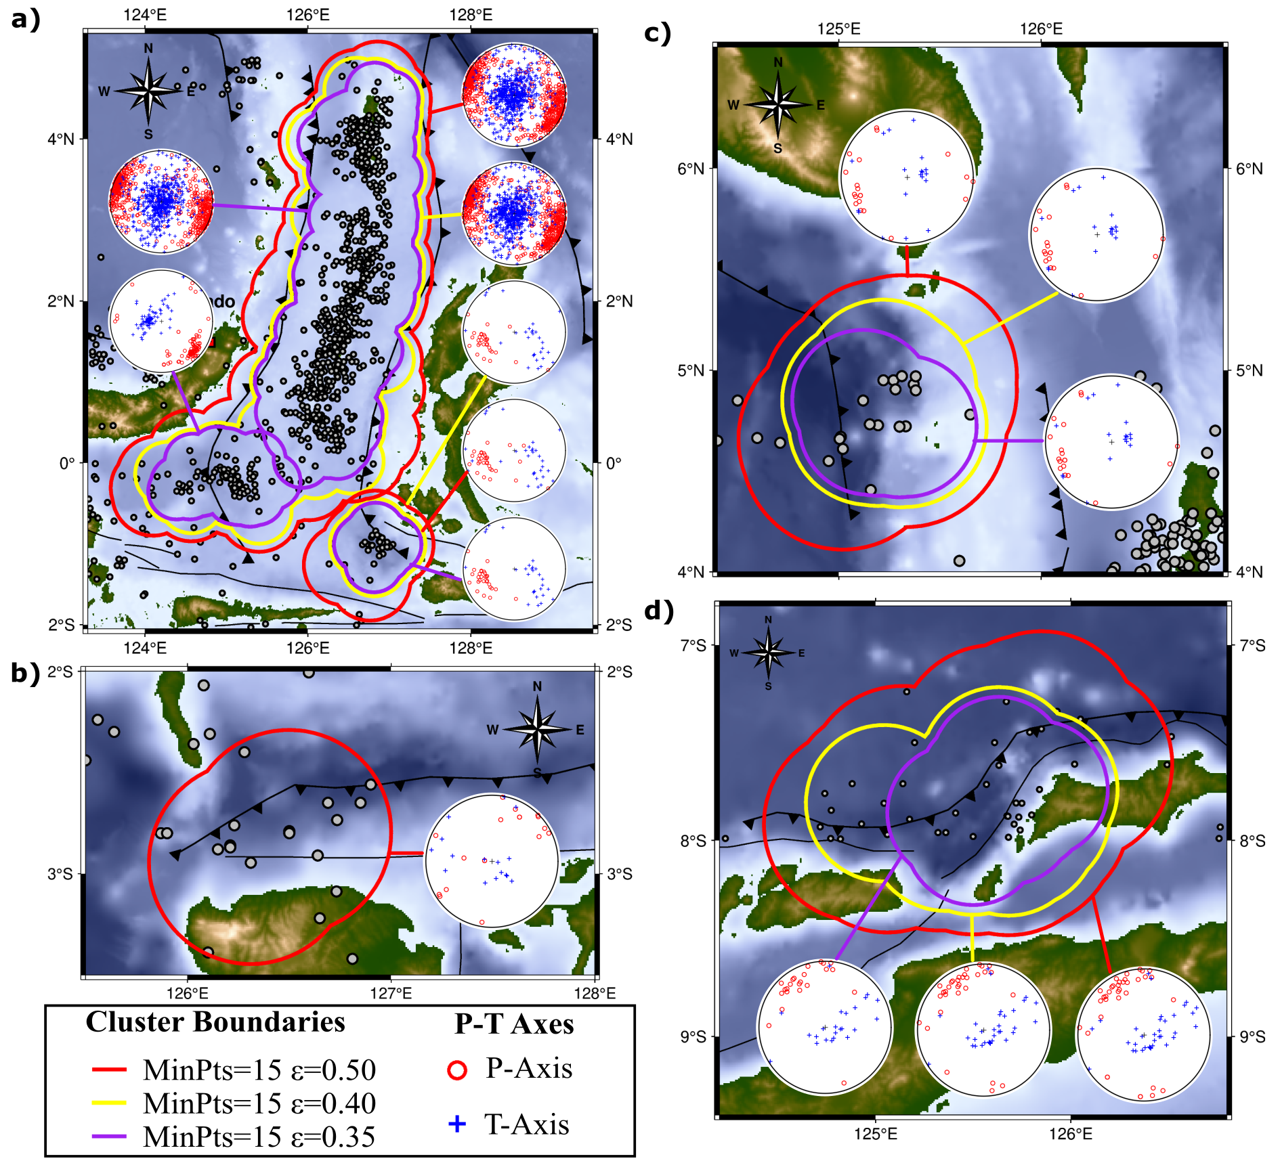
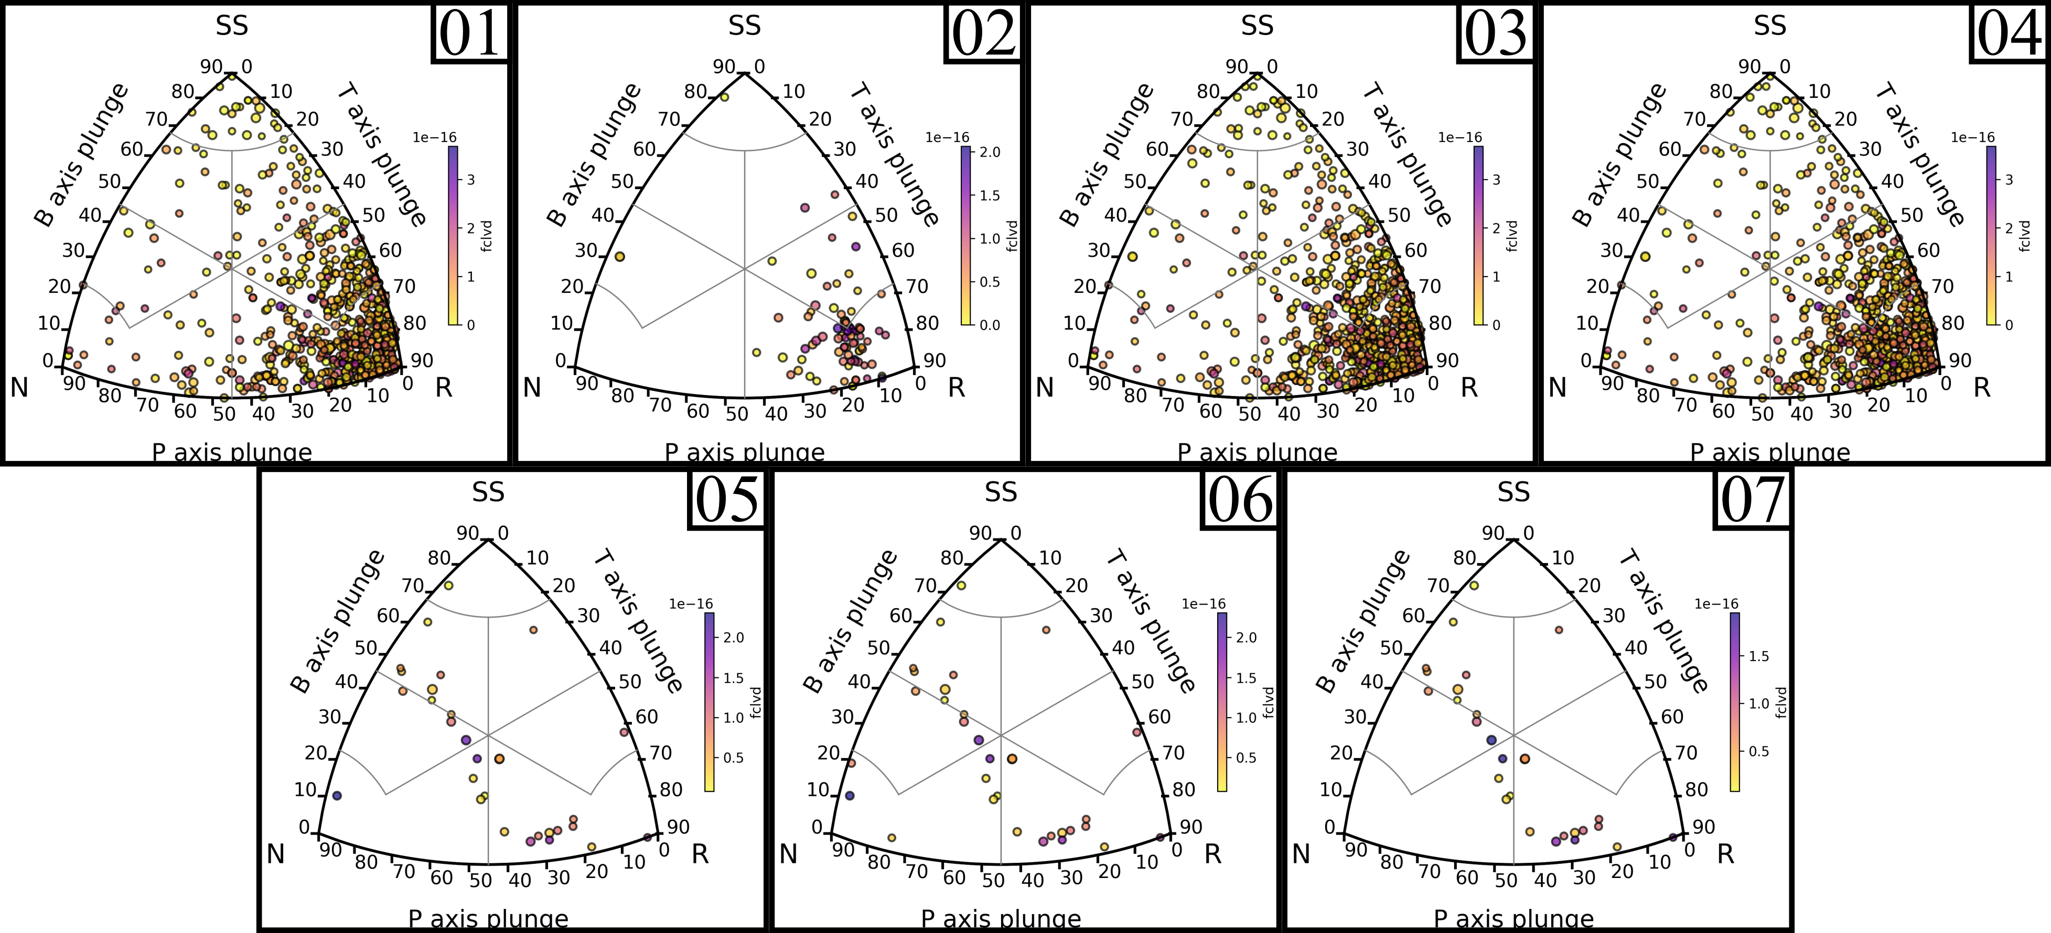
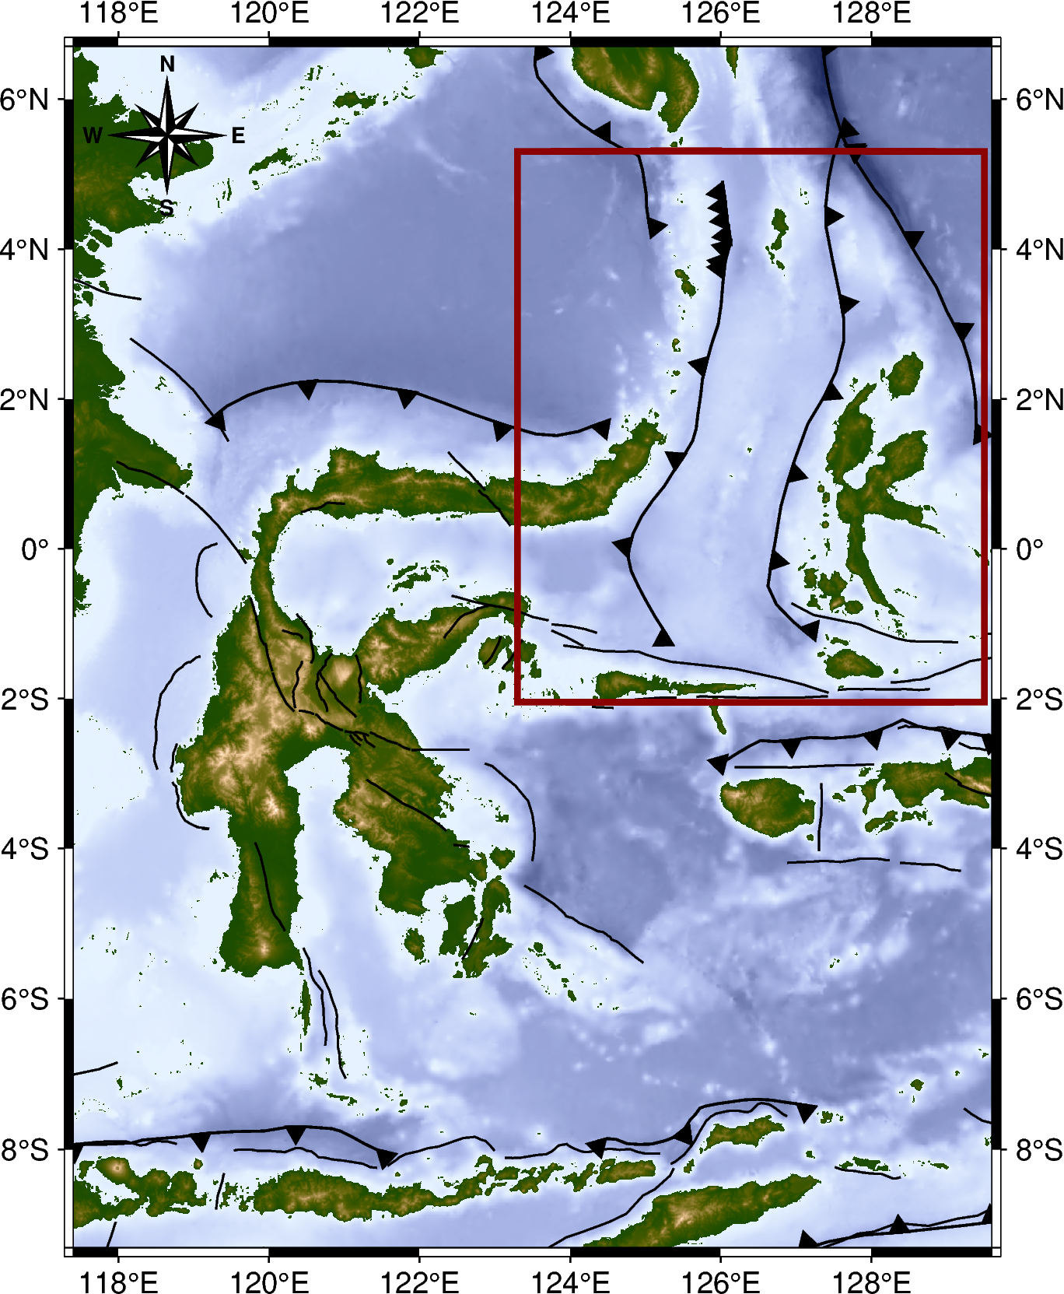
$$Clustering Result$$
Maluku Sea Area
03
01
04
02
05
06
07

Slide 7
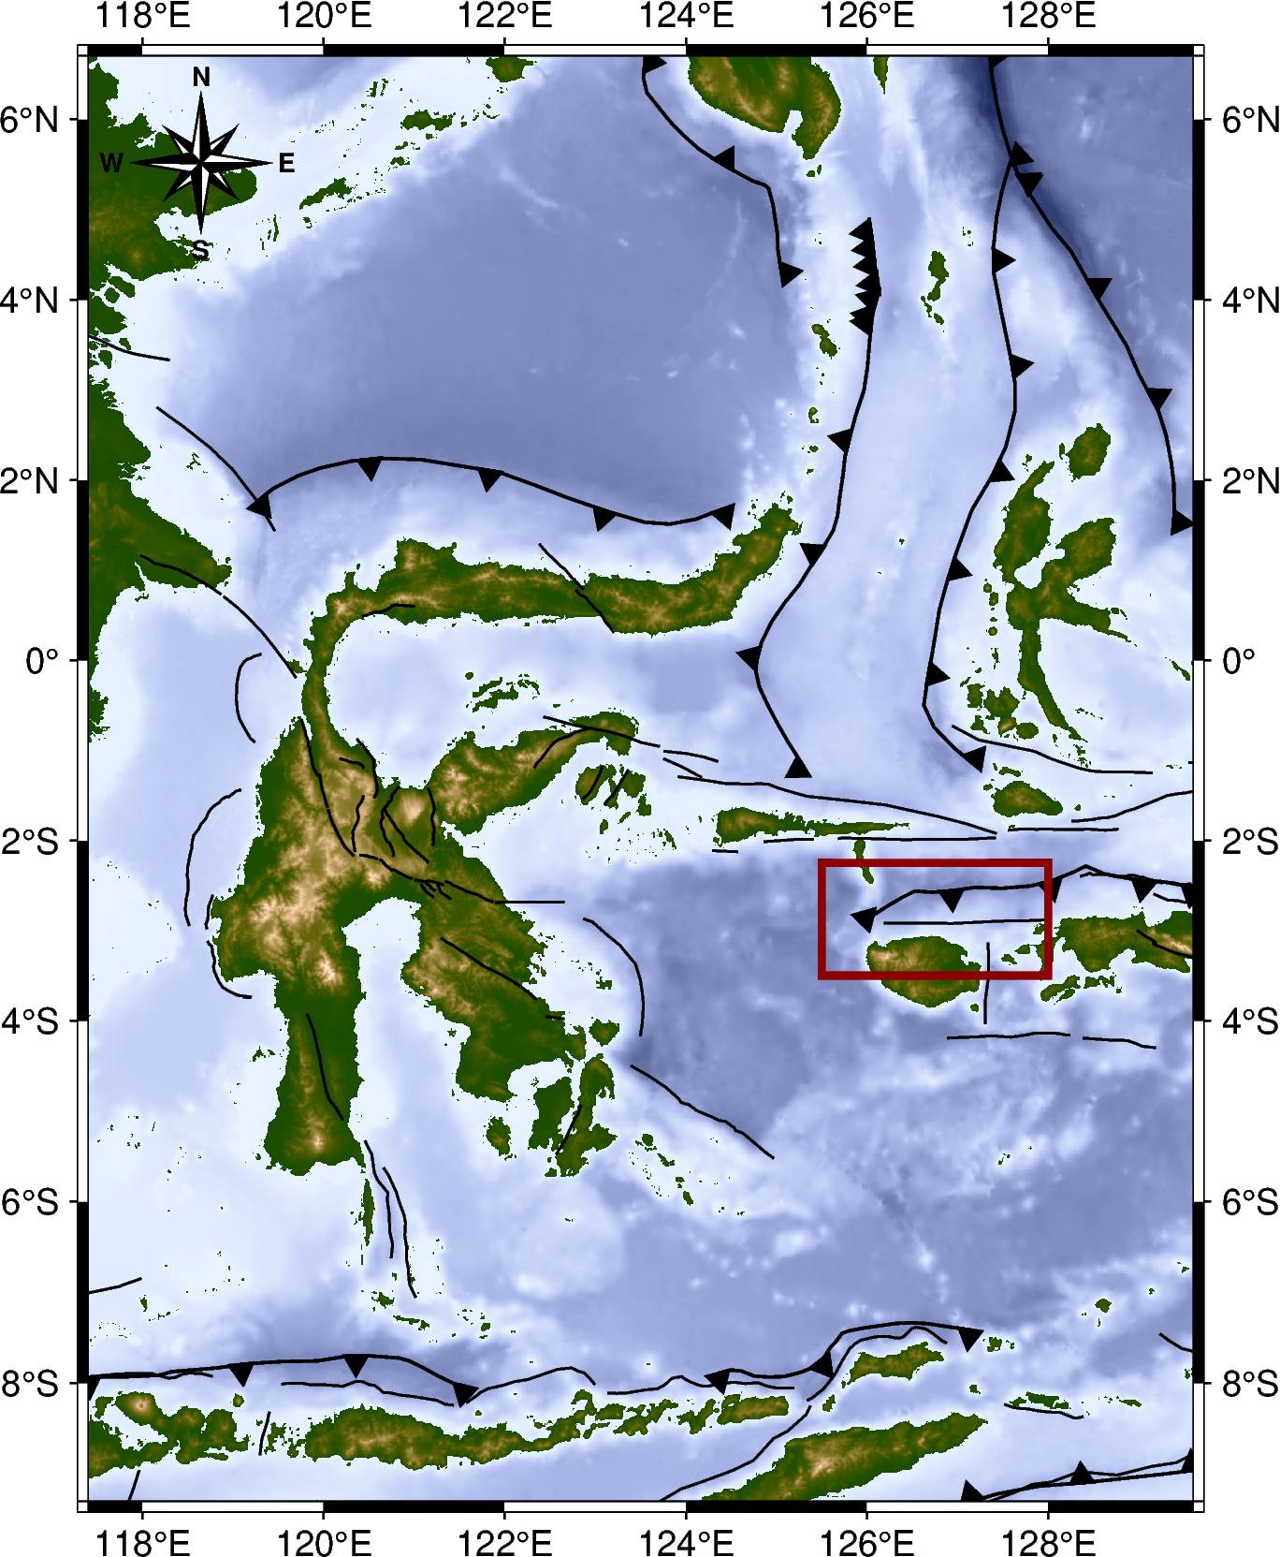
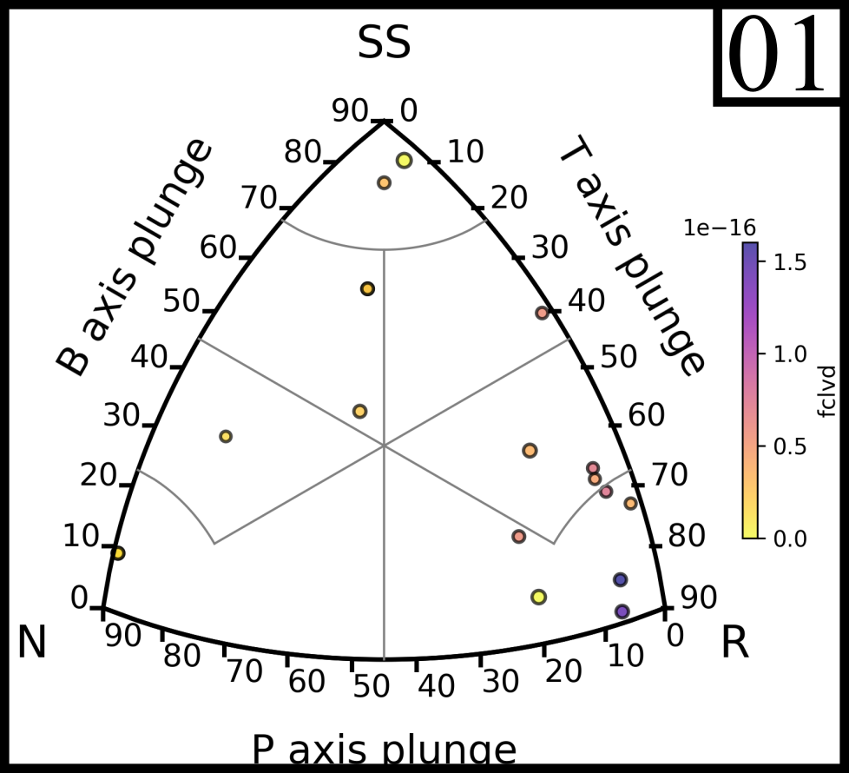
$$Clustering Result$$
Sula Area

Slide 8
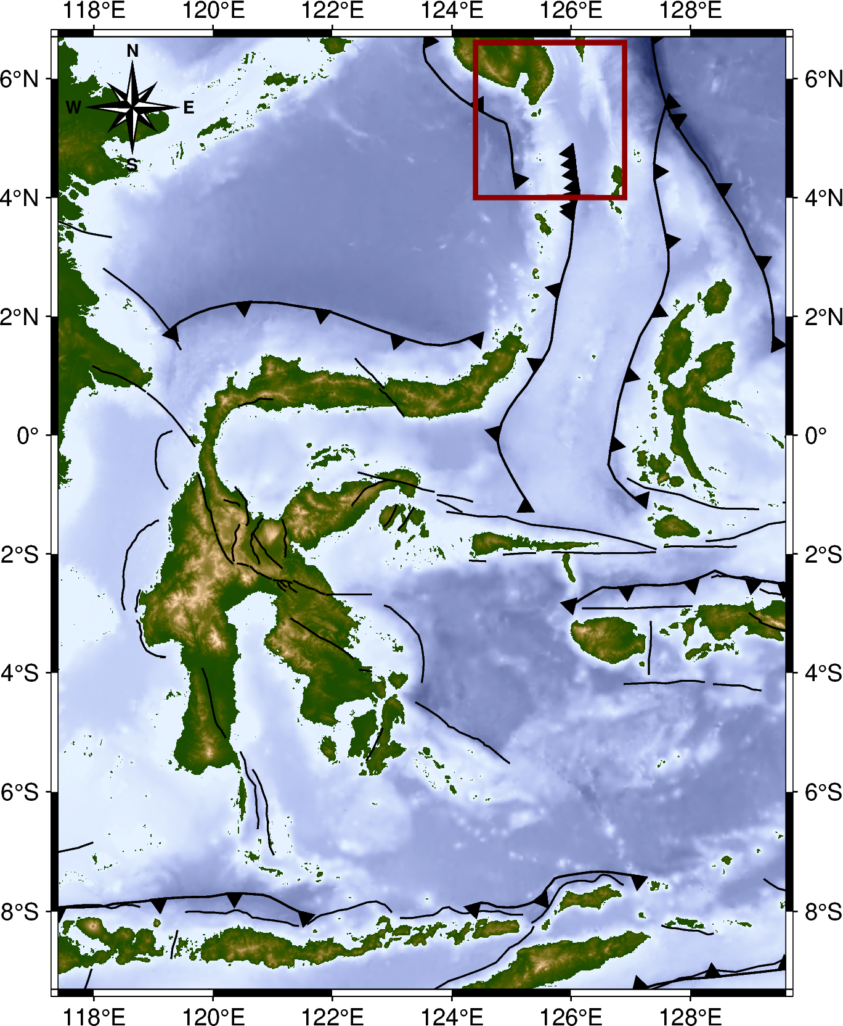
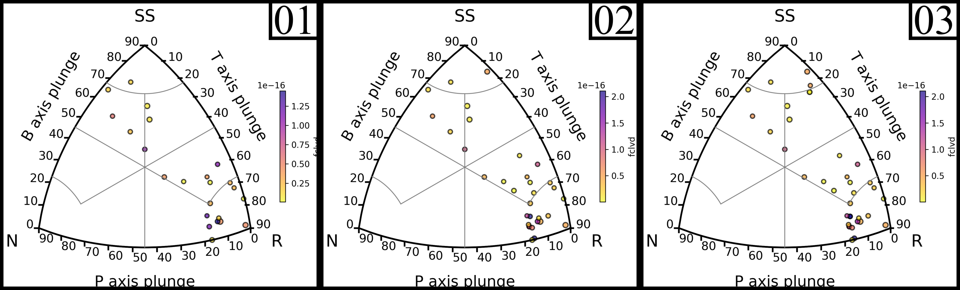
$$Clustering Result$$
Western Sangihe Area
01
02
03

Slide 9
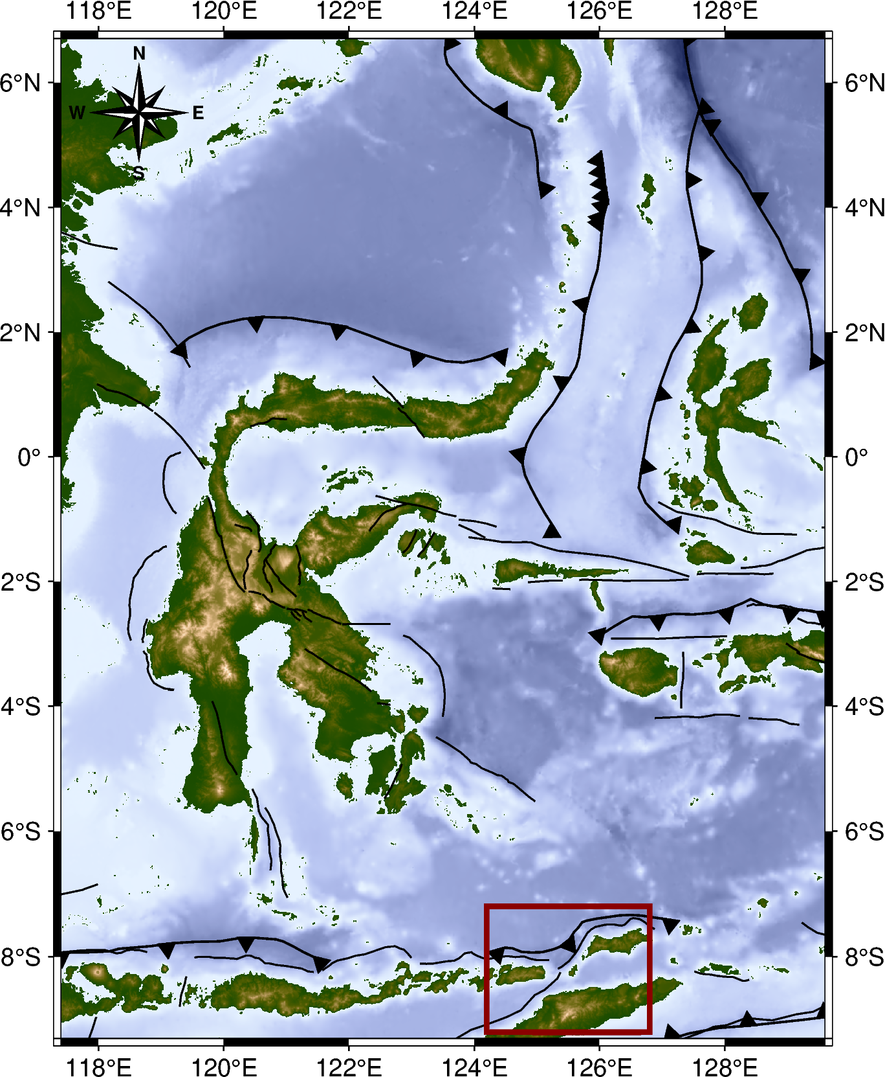
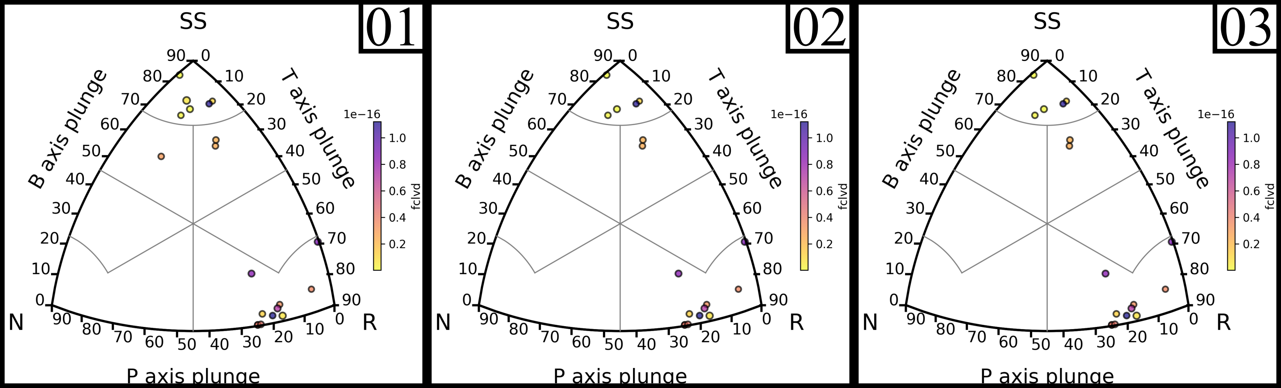
$$Clustering Result$$
Nusa Tenggara Timur Area
01
02
03

Slide 10
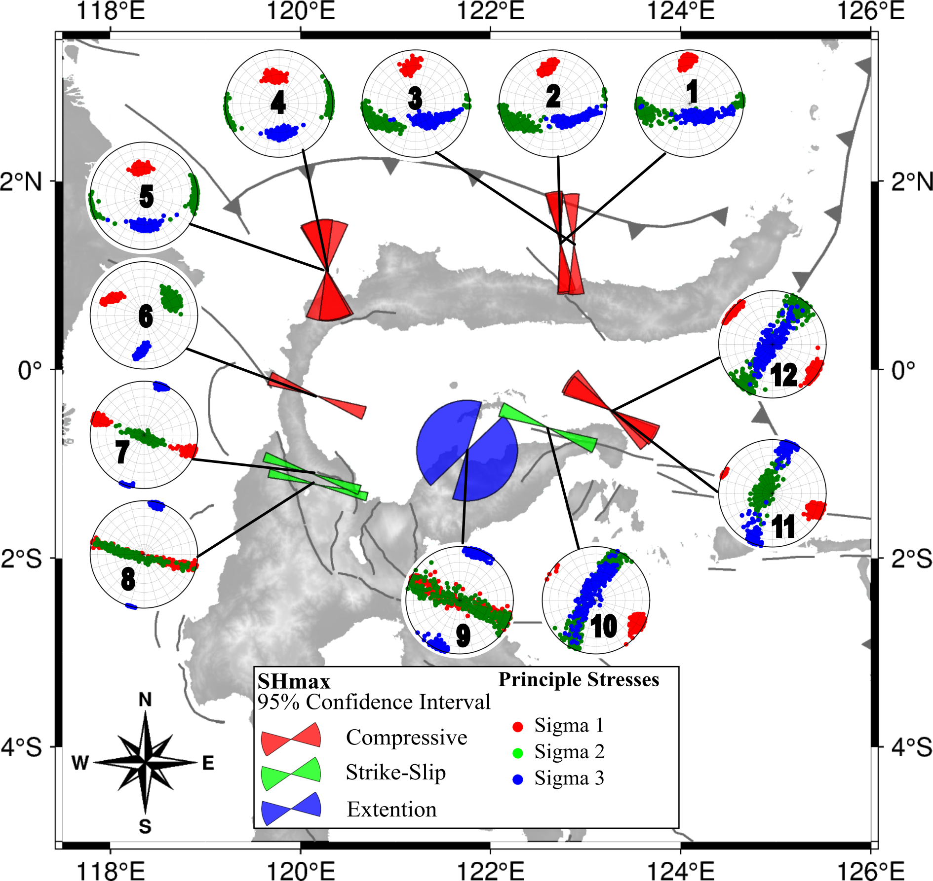
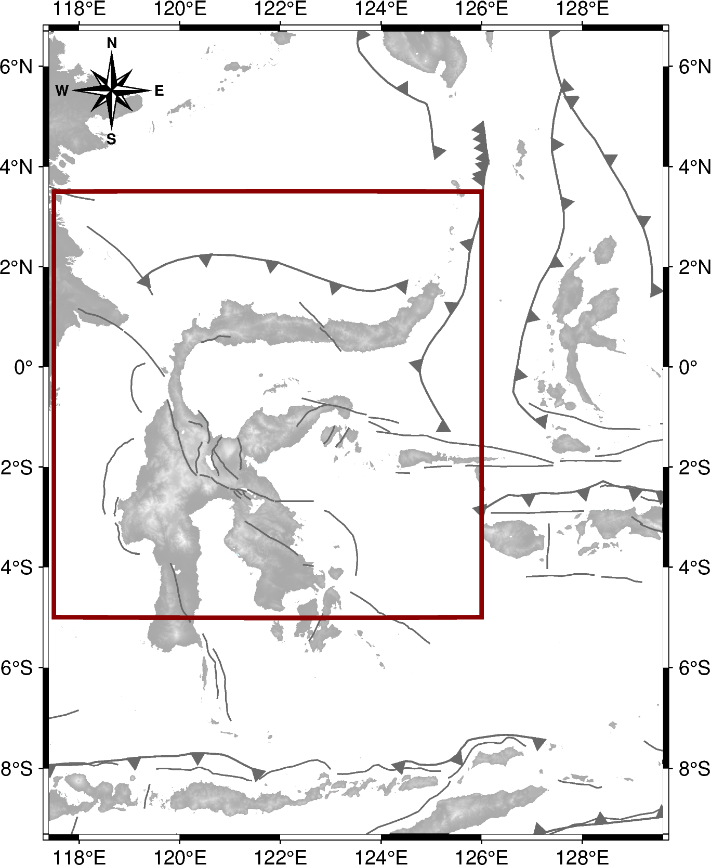
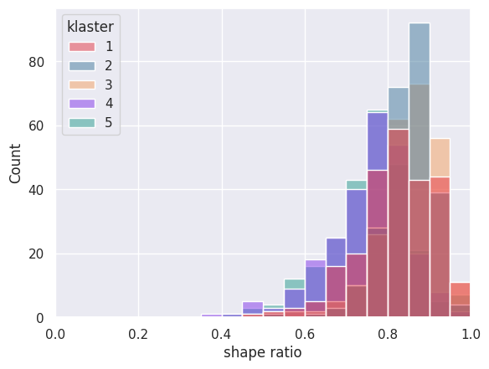
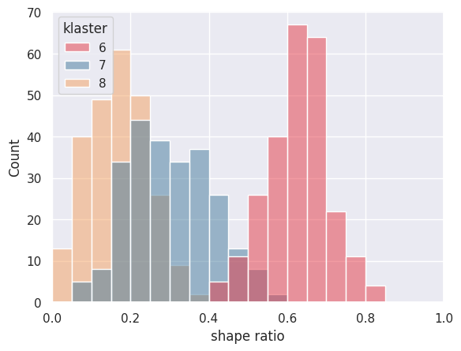
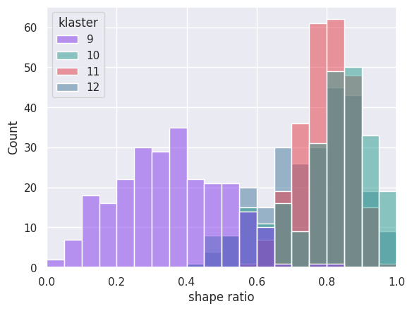
$$Stress Inversion Result$$
Northern Sulawesi
Cluster (event) | Sigma 1 (˚) azimuth/plunge | Sigma 2 (˚) azimuth/plunge | Sigma 3 (˚) azimuth/plunge | R | SHmax | Aφ
Northern Sulawesi
1 (96) | 356/22 ± 09/11 | 255/29 ± 20/28 | 156/51 ± 58/27 | 0.786 ± 0.181 | 357 ± 09 | 2.13
2 (81) | 350/32 ± 11/10 | 241/23 ± 26/22 | 137/44 ± 37/22 | 0.826 ± 0.120 | 352 ± 10 | 2.14
3 (78) | 352/30 ± 11/11 | 245/23 ± 28/22 | 142/46 ± 42/24 | 0.795 ± 0.160 | 354 ± 09 | 2.14
4 (47) | 351/47 ± 16/08 | 083/05 ± 19/05 | 174/43 ± 22/08 | 0.705 ± 0.210 | 356 ± 28 | 2.23
5 (49) | 353/47 ± 14/08 | 265/07 ± 19/06 | 178/43 ± 22/07 | 0.745 ± 0.205 | 349 ± 18 | 2.23
6 (96) | 299/32 ± 10/11 | 059/41 ± 18/11 | 183/33 ± 07/10 | 0.617 ± 0.163 | 290 ± 08 | 2.37
7 (62) | 289/15 ± 06/15 | 121/74 ± 73/14 | 019/04 ± 05/04 | 0.308 ± 0.203 | 289 ± 06 | 1.72
8 (44) | 288/40 ± 09/38 | 106/47 ± 52/36 | 013/05 ± 05/05 | 0.177 ± 0.138 | 284 ± 05 | 1.89
9 (16) | 289/43 ± 50/41 | 123/44 ± 50/41 | 204/08 ± 15/08 | 0.365 ± 0.275 | 301 ± 75 | 0.98
10 (24) | 120/13 ± 11/12 | 206/35 ± 28/32 | 357/49 ± 74/33 | 0.731 ± 0.235 | 120 ± 12 | 2.10
11 (53) | 111/14 ± 08/13 | 283/64 ± 84/20 | 024/22 ± 14/22 | 0.788 ± 0.146 | 111 ± 08 | 1.17
12 (18) | 306/09 ± 15/09 | 215/29 ± 19/28 | 040/60 ± 70/27 | 0.744 ± 0.212 | 306 ± 16 | 2.14

Slide 11
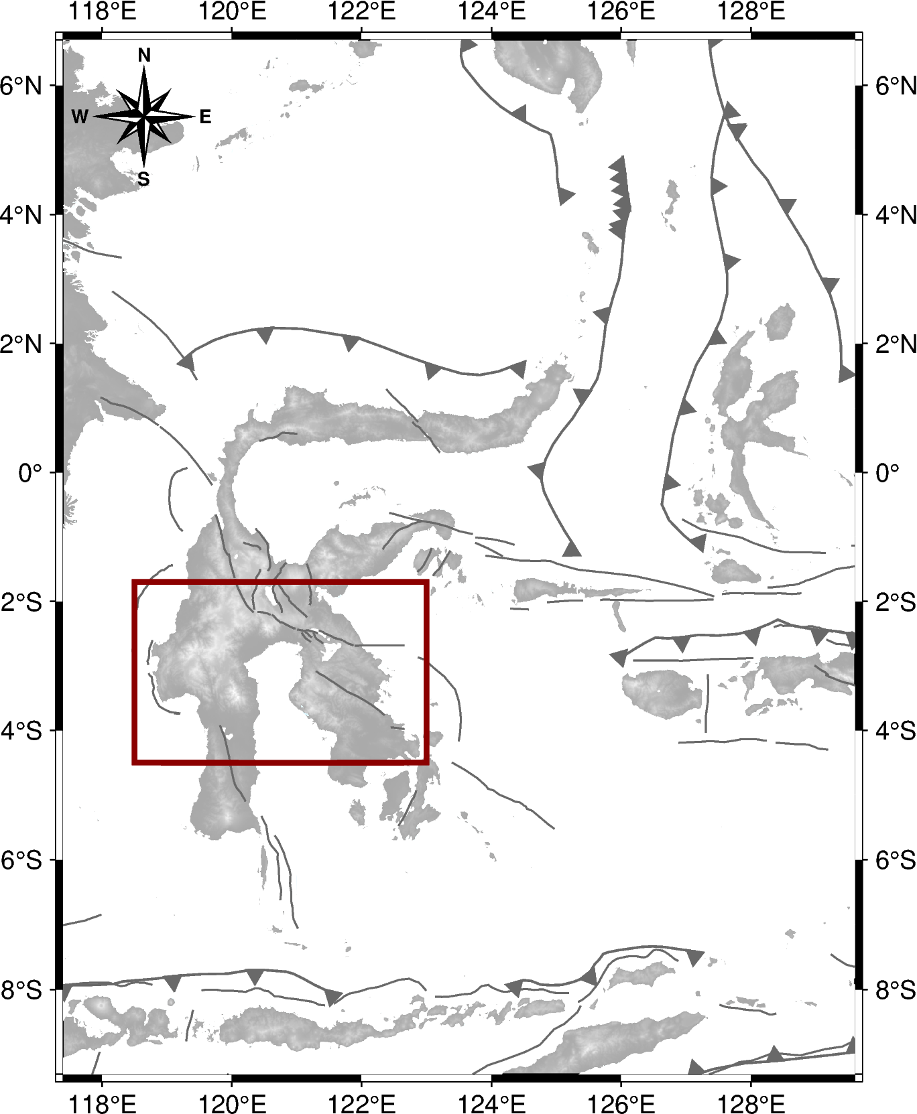
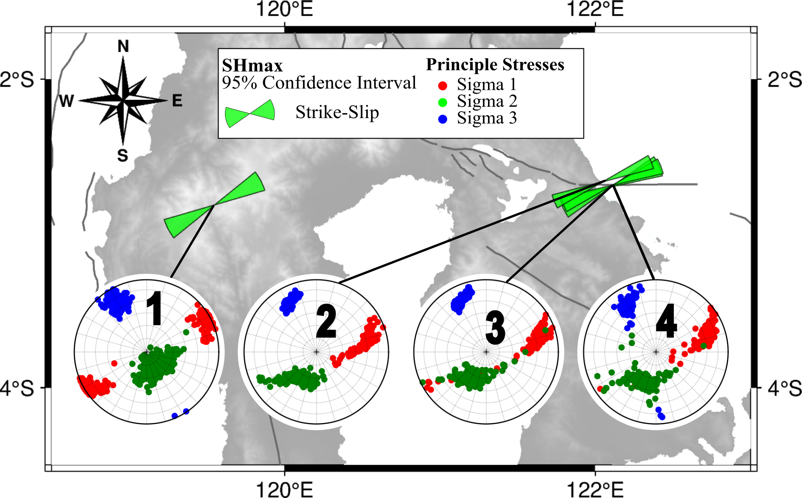
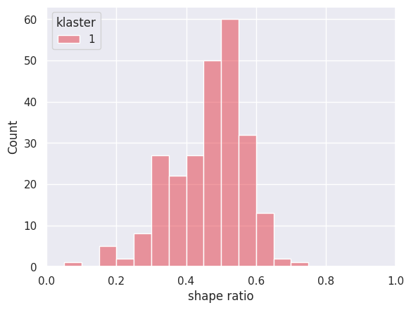
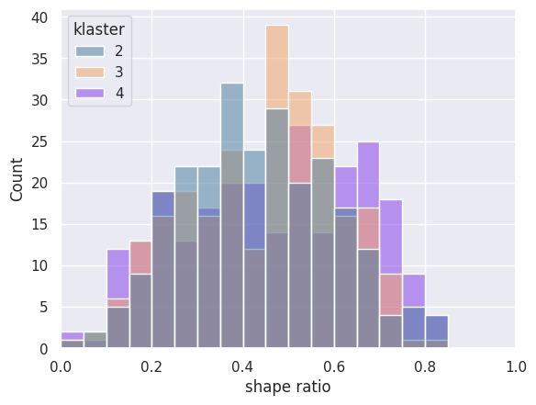
$$Stress Inversion Result$$
Southern Sulawesi
Cluster (event) | Sigma 1 (˚) azimuth/plunge | Sigma 2 (˚) azimuth/plunge | Sigma 3 (˚) azimuth/plunge | R | SHmax | Aφ
Southern Sulawesi
1 (15) | 243/14 ± 15/14 | 146/67 ± 62/15 | 329/18 ± 10/15 | 0.433 ± 0.193 | 242 ± 11 | 1.56
2 (22) | 081/37 ± 17/22 | 211/44 ± 25/18 | 333/23 ± 09/07 | 0.451 ± 0.309 | 068 ± 08 | 1.57
3 (19) | 074/26 ± 13/18 | 204/53 ± 36/13 | 335/21 ± 09/07 | 0.423 ± 0.296 | 068 ± 09 | 1.55
4 (18) | 072/29 ± 15/21 | 194/47 ± 41/15 | 330/24 ± 10/11 | 0.550 ± 0.316 | 066 ± 11 | 1.46

Slide 12
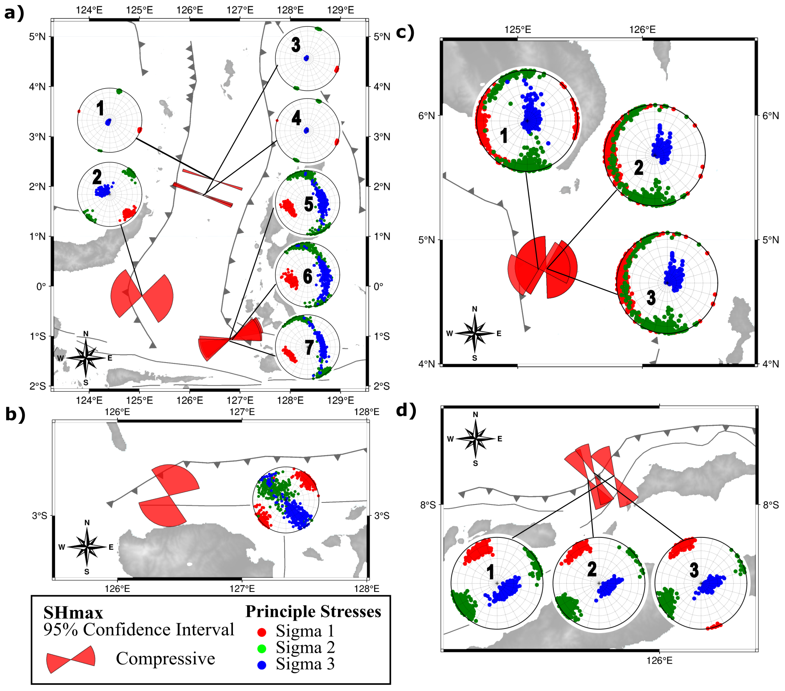
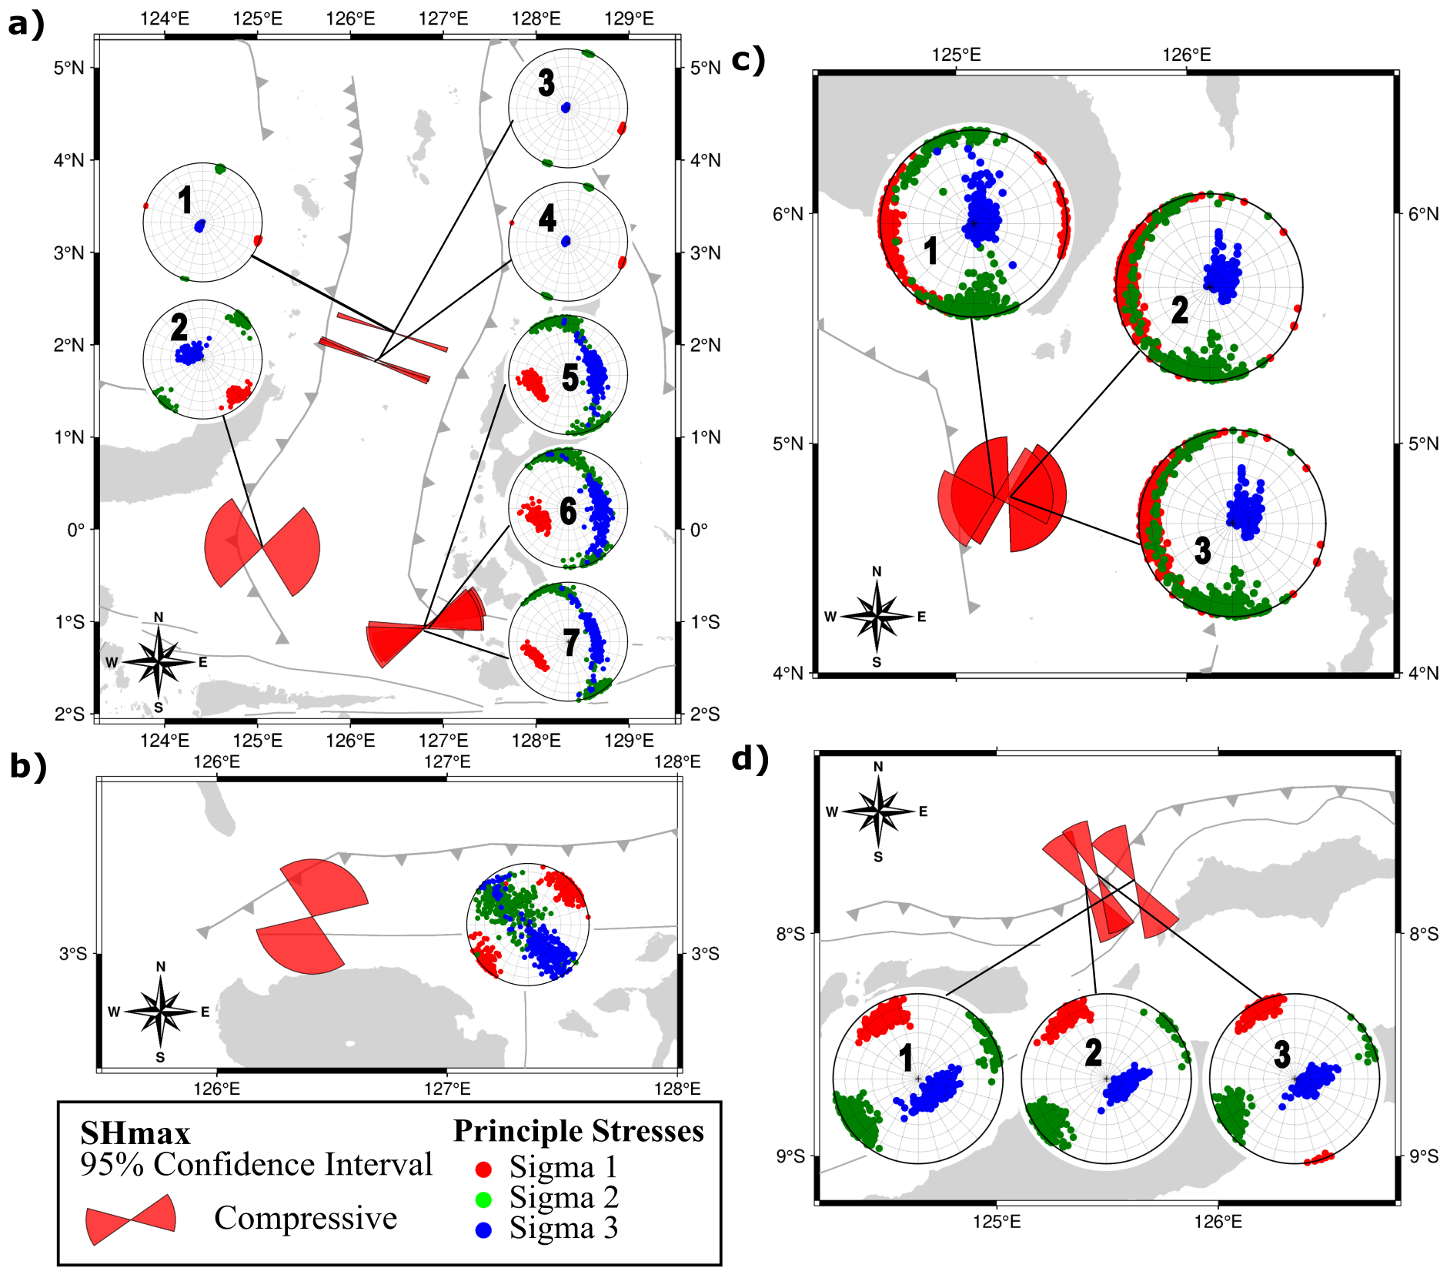
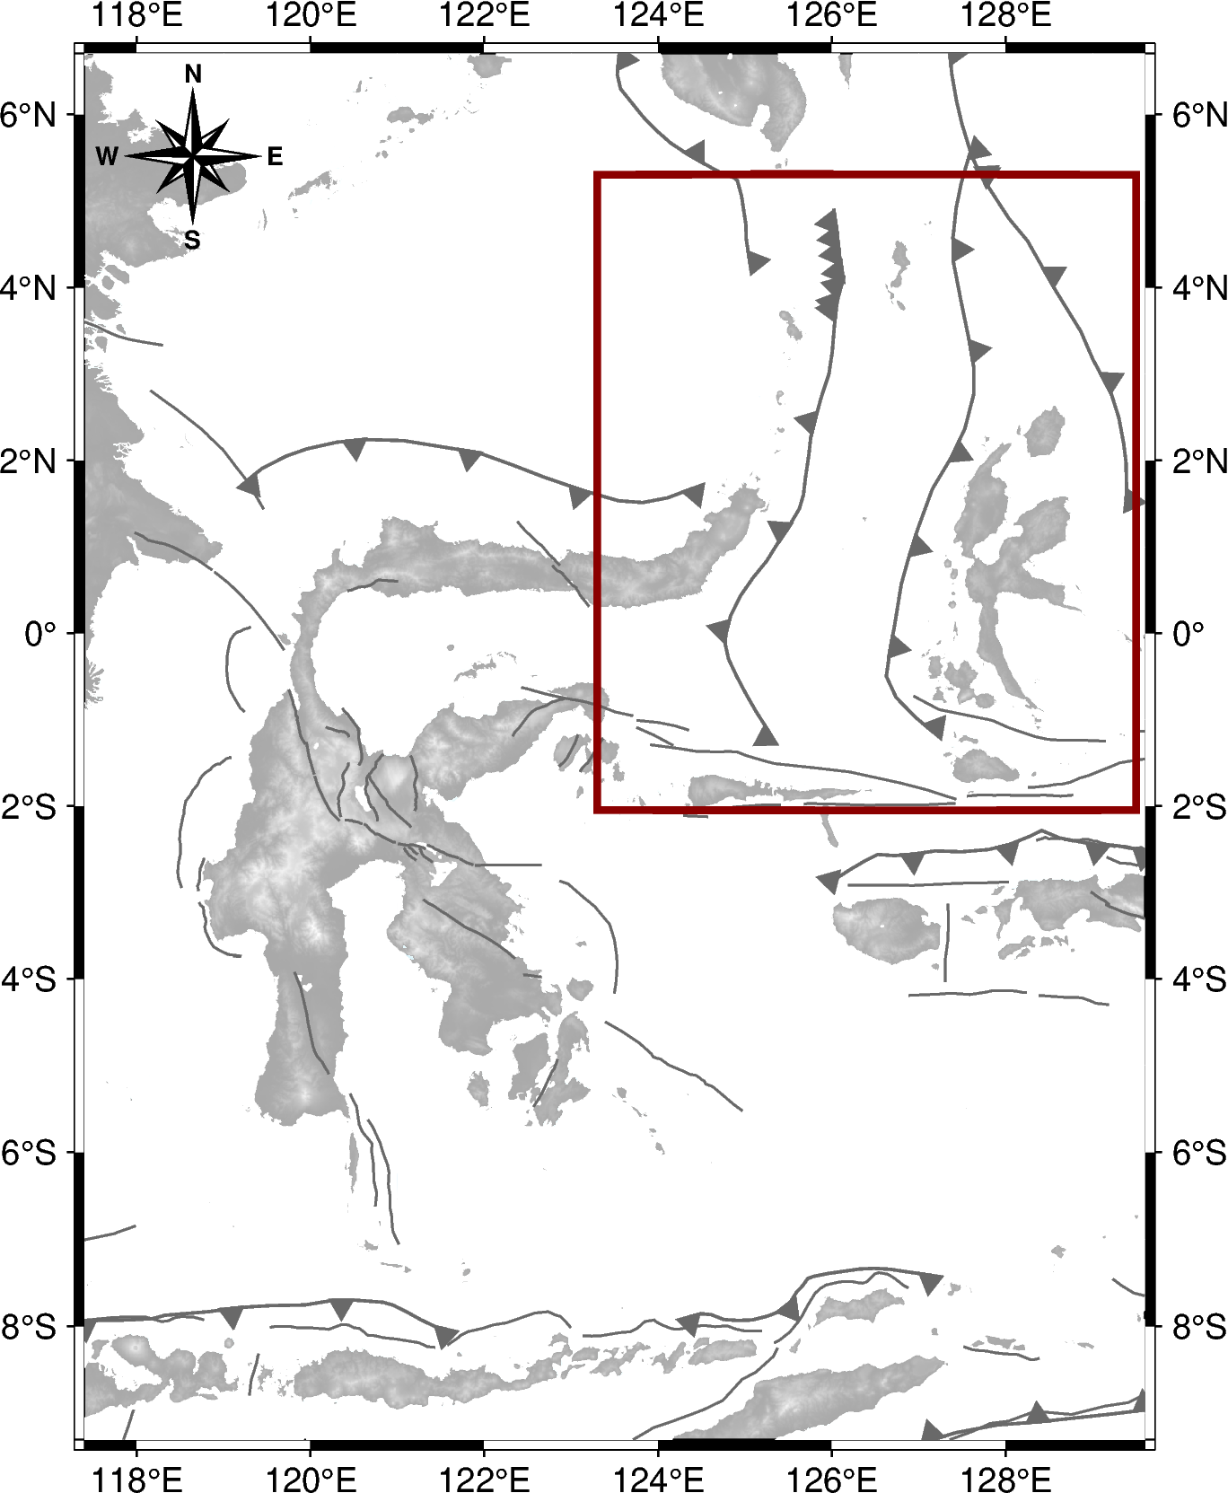
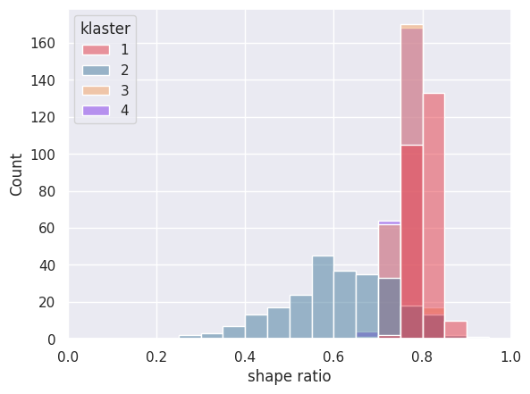
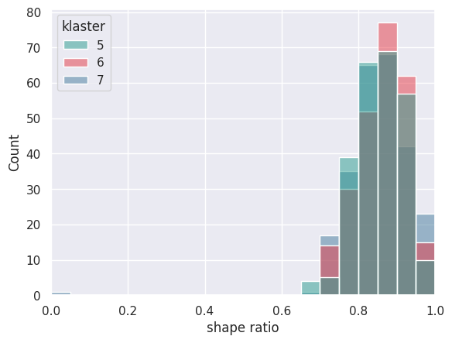
$$Stress Inversion Result$$
Wilayah Laut Maluku
Cluster (event) | Sigma 1 (˚) azimuth/plunge | Sigma 2 (˚) azimuth/plunge | Sigma 3 (˚) azimuth/plunge | R | SHmax | Aφ
Maluku Sea Area
1 (638) | 108/03 ± 02/02 | 018/05 ± 02/04 | 230/84 ± 28/04 | 0.809 ± 0.046 | 108 ± 02 | 2.20
2 (93) | 135/17 ± 09/10 | 044/09 ± 10/09 | 300/70 ± 37/11 | 0.603 ± 0.234 | 097 ± 51 | 2.37
3 (749) | 111/04 ± 03/02 | 021/02 ± 03/02 | 291/86 ± 51/02 | 0.765 ± 0.046 | 111 ± 03 | 2.24
4 (742) | 110/03 ± 03/02 | 200/02 ± 03/02 | 291/86 ± 51/02 | 0.759 ± 0.047 | 110 ± 03 | 2.23
5 (30) | 249/38 ± 21/11 | 347/20 ± 30/20 | 082/45 ± 59/15 | 0.857 ± 0.120 | 253 ± 22 | 2.14
6 (32) | 251/44 ± 20/12 | 000/18 ± 44/18 | 095/34 ± 56/20 | 0.854 ± 0.116 | 249 ± 23 | 2.12
7 (28) | 244/37 ± 17/07 | 346/25 ± 35/25 | 072/39 ± 65/16 | 0.852 ± 0.116 | 245 ± 16 | 2.11

Slide 13
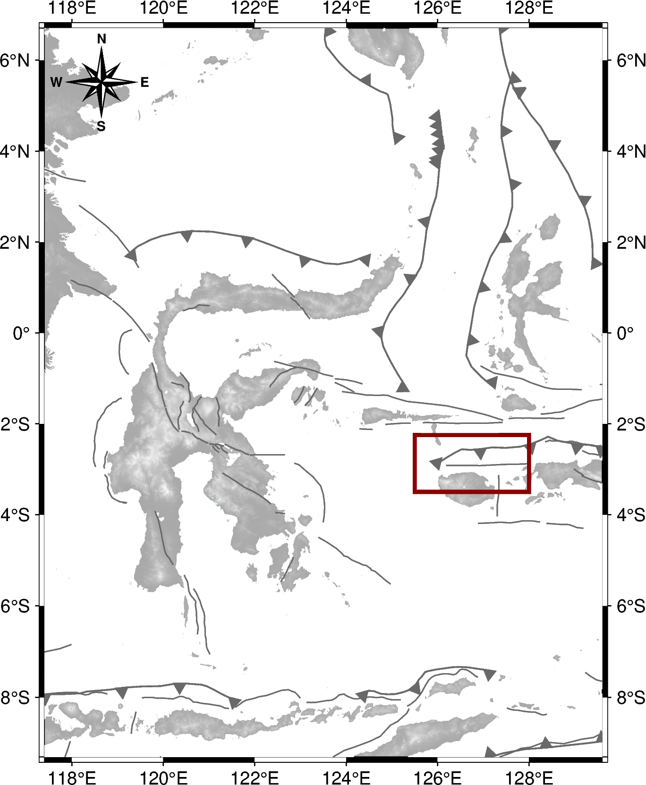
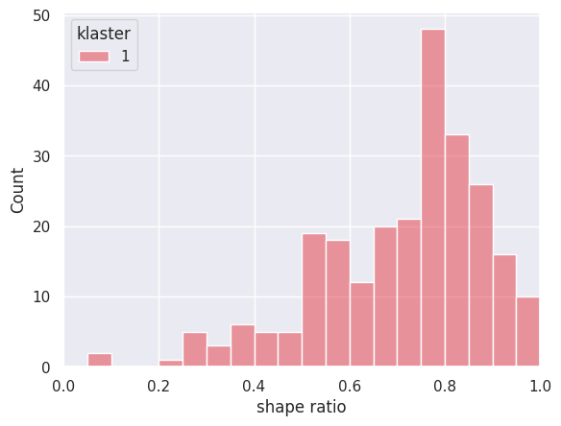
$$Stress Inversion Result$$
Wilayah Sula
Cluster (event) | Sigma 1 (˚) azimuth/plunge | Sigma 2 (˚) azimuth/plunge | Sigma 3 (˚) azimuth/plunge | R | SHmax | Aφ
Sula Area
1 (18) | 047/16 ± 24/15 | 305/42 ± 69/36 | 149/41 ± 39/38 | 0.621 ± 0.339 | 021 ± 55 | 2.17

Slide 14
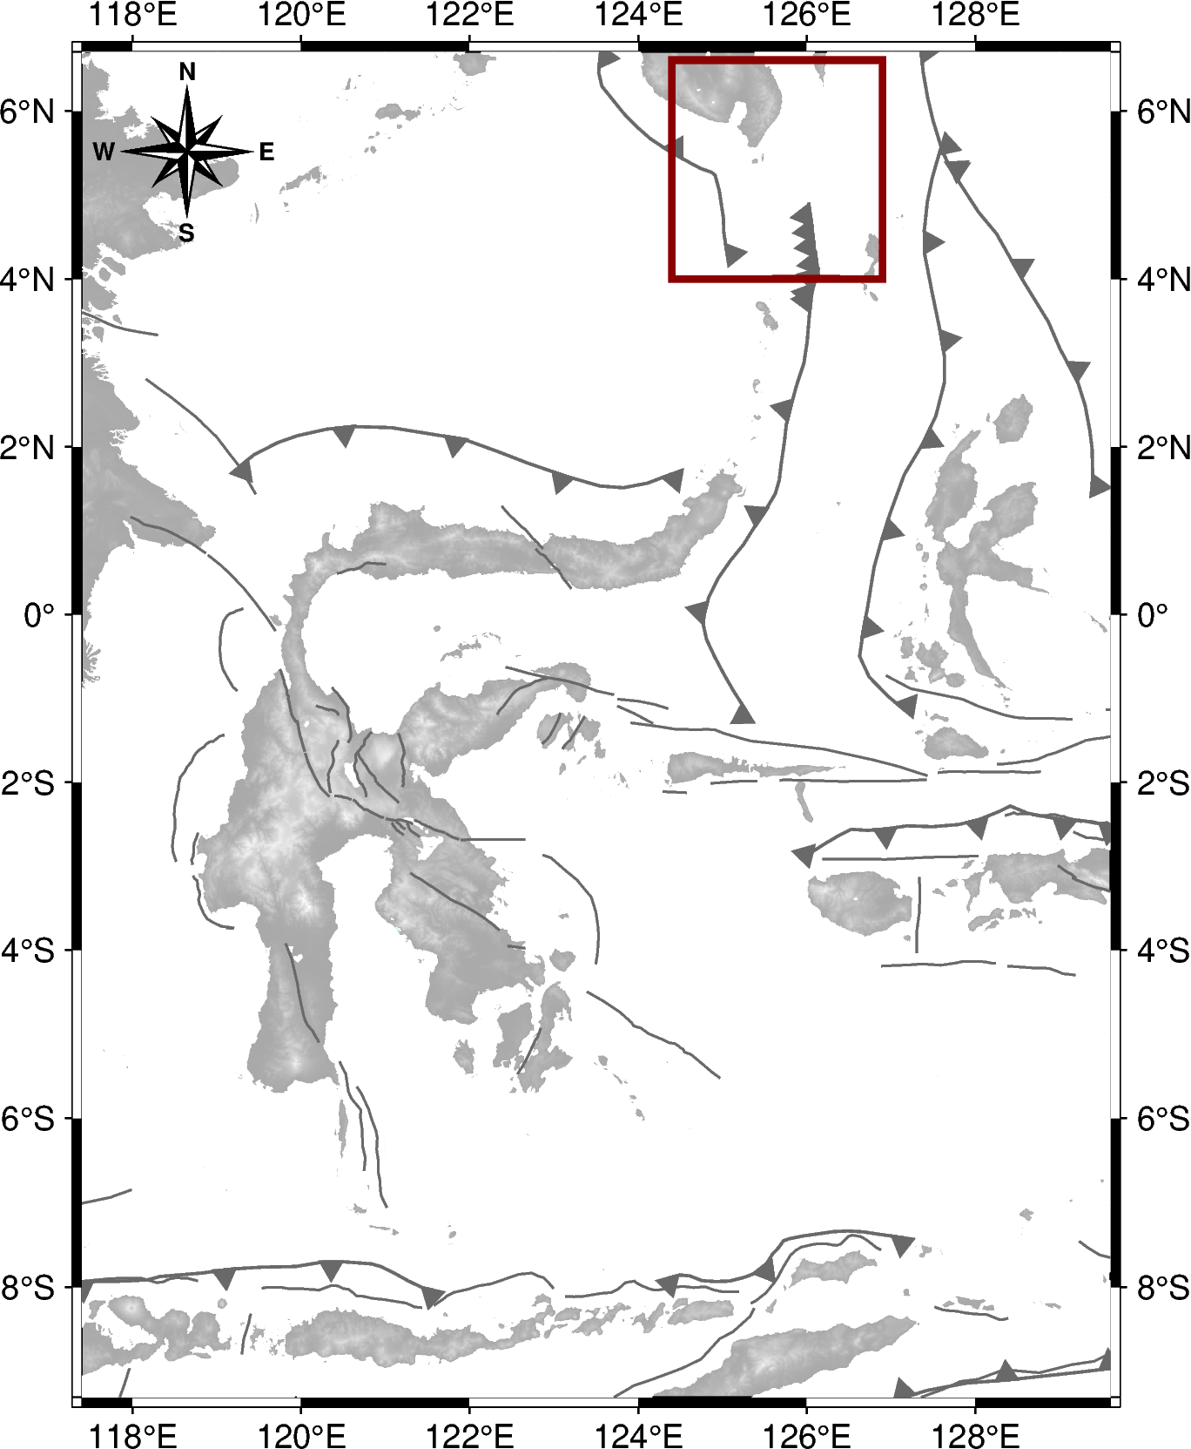
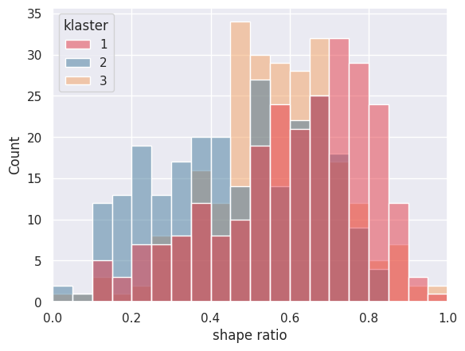
$$Stress Inversion Result$$
Wilayah Sangihe Barat
Cluster (event) | Sigma 1 (˚) azimuth/plunge | Sigma 2 (˚) azimuth/plunge | Sigma 3 (˚) azimuth/plunge | R | SHmax | Aφ
Western Sangihe Area
1 (20) | 256/08 ± 42/08 | 166/23 ± 41/23 | 018/66 ± 81/22 | 0.526 ± 0.355 | 254 ± 43 | 2.41
2 (18) | 282/11 ± 73/10 | 193/16 ± 73/15 | 051/70 ± 55/16 | 0.442 ± 0.333 | 284 ± 74 | 2.68
3 (15) | 282/11 ± 73/10 | 193/16 ± 73/15 | 051/70 ± 55/16 | 0.442 ± 0.333 | 284 ± 74 | 2.68

Slide 15
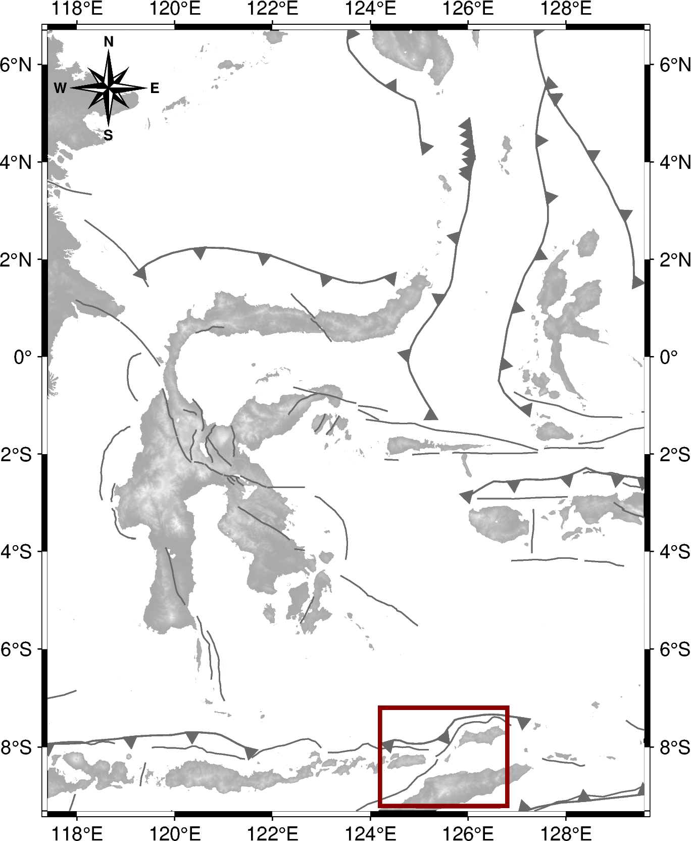
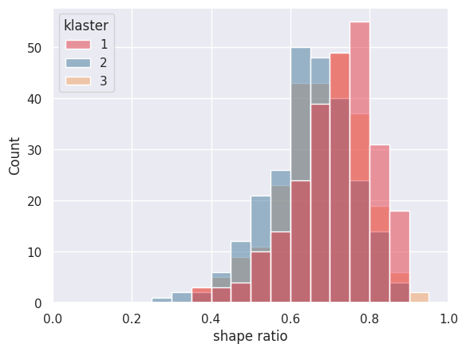
$$Stress Inversion Result$$
Wilayah Nusa Tenggara Timur
Cluster (event) | Sigma 1 (˚) azimuth/plunge | Sigma 2 (˚) azimuth/plunge | Sigma 3 (˚) azimuth/plunge | R | SHmax | Aφ
Nusa Tenggara Timur Area
1 (23) | 329/18 ± 19/11 | 238/15 ± 20/14 | 136/66 ± 55/11 | 0.672 ± 0.203 | 330 ± 20 | 2.25
2 (33) | 326/14 ± 16/09 | 233/15 ± 17/15 | 122/67 ± 44/13 | 0.618 ± 0.211 | 328 ± 18 | 2.34
3 (37) | 333/09 ± 14/09 | 242/16 ± 15/15 | 101/70 ± 49/13 | 0.649 ± 0.210 | 335 ± 14 | 2.27

